Slide 1
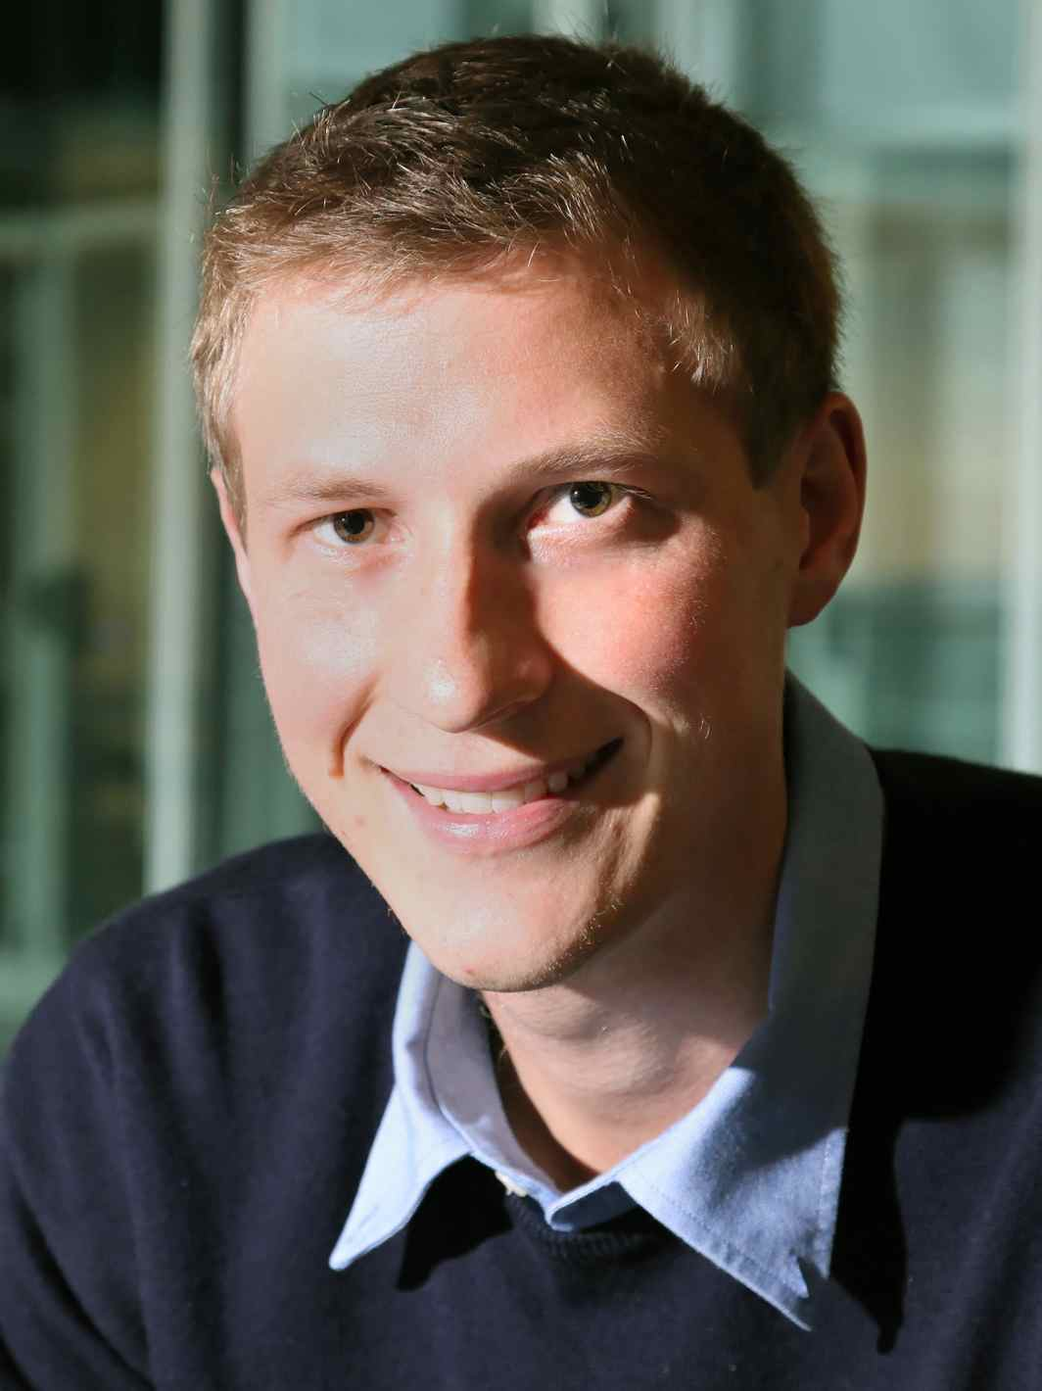
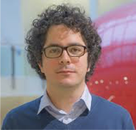
A Constant-Factor Approximation Algorithm for the Asymmetric Traveling Salesman Problem
Ola Svensson, Jakub Tarnawski and László A. Végh

Slide 2
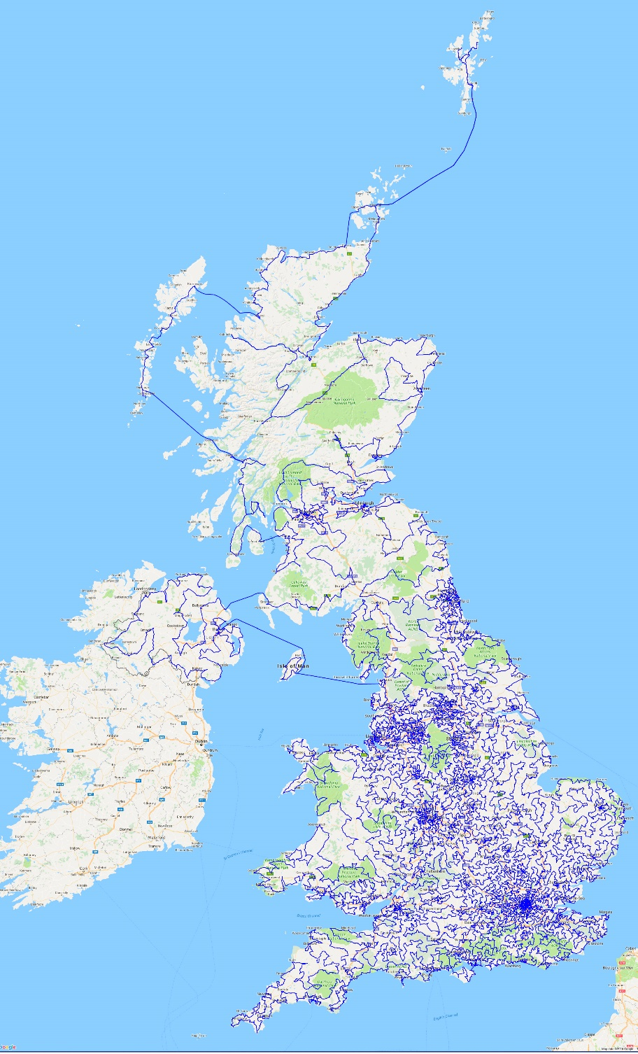
What's the cheapest way to visit all 24727 pubs in the UK?
45,495,239 meters
Cook, Espinoza, Goycoolea, Helsgaun (2015)

Slide 3

Find the shortest tour that visits n given cities

Slide 4
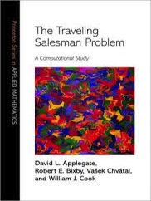

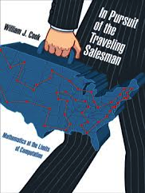

Traveling Salesman Problem
Variants studied in mathematics by Hamilton and Kirkman already in the 1800’s
Benchmark problem: one of the most studied NP-hard optimization problems
Intractable: (current) exact algorithms require exponential time
  Focus: approximation algorithms
Notes:
There are several books about TSP

Slide 5
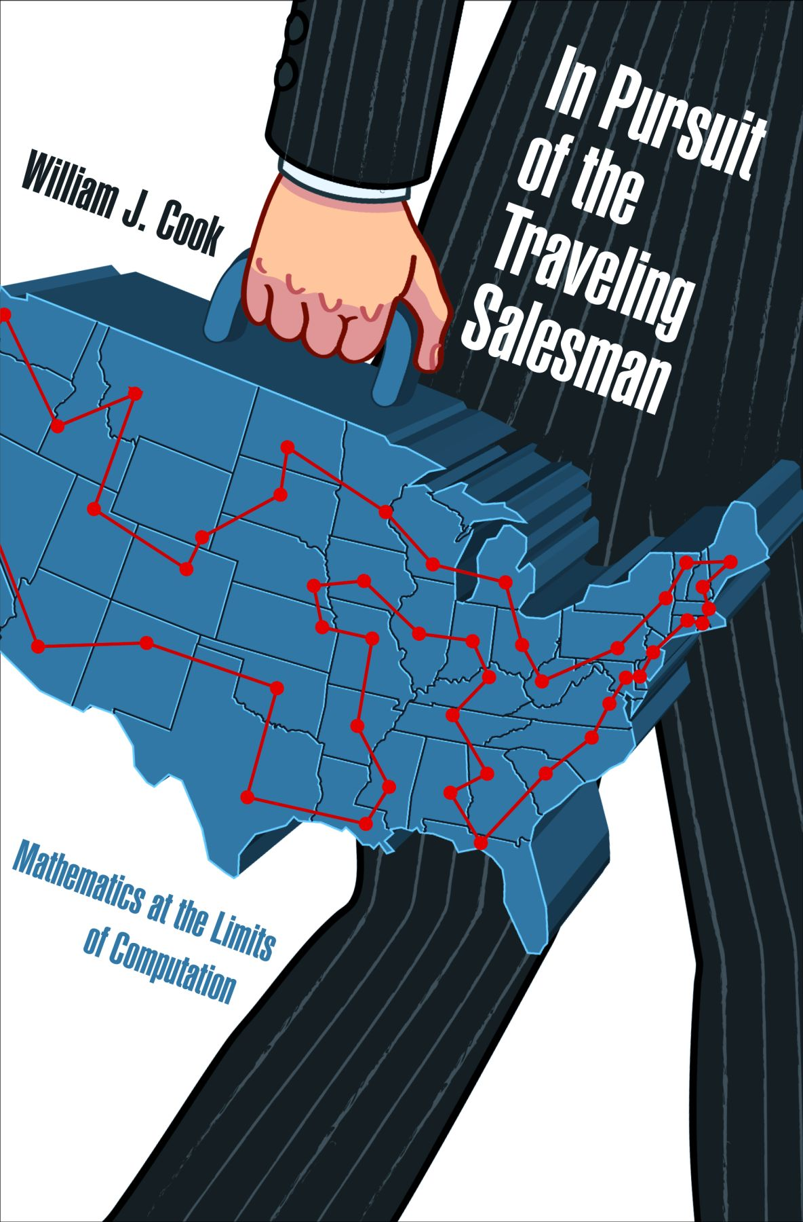
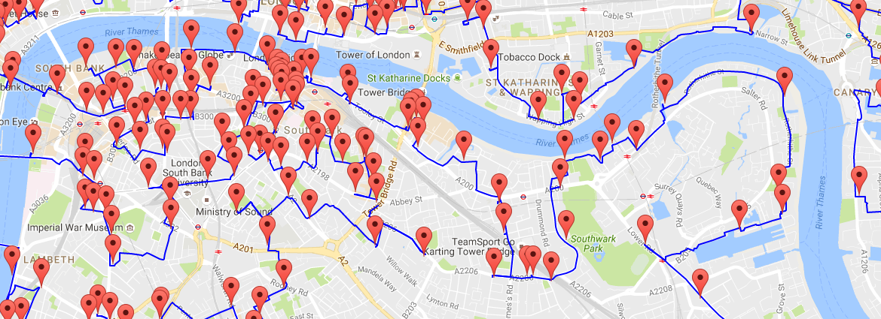
Traveling Salesman Problem
Variants studied in mathematics by Hamilton and Kirkman already in the 1800’s
Benchmark problem:
  one of the most studied
  NP-hard optimization problems
  yet our understanding
  is quite incomplete
  What can be accomplished
  with efficient computation
  (approximation algorithms)?
Notes:
There are several books about TSP

Slide 6
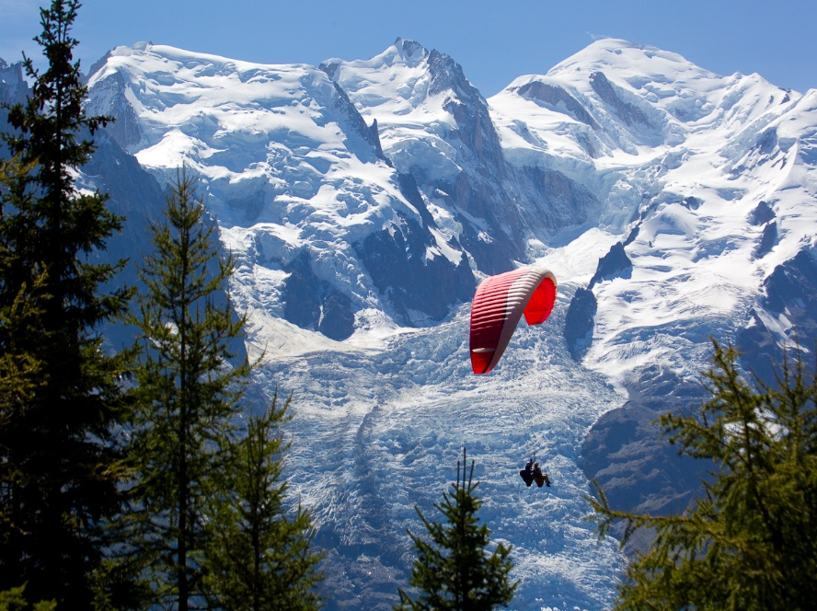
Two basic versions
Symmetric: distance(u,v) = distance(v,u)
3
2-approximation is trivial
1.5-approximation [Christofides’76] taught in undergrad courses, still unbeaten
u
v
3
Asymmetric: more general, no such assumption is made
v
100
2
u

Slide 7
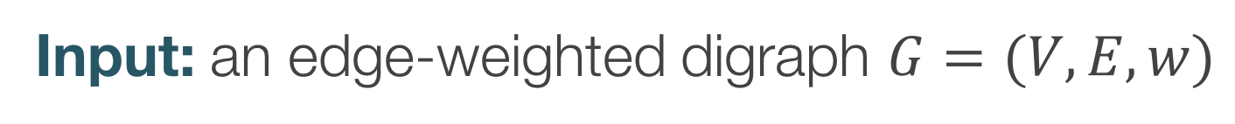
Asymmetric Traveling Salesman Problem
Input: an edge-weighted digraph $G=(V,E,w)$
Output: a minimum-weight tour that visits each vertex at least once
3
1
5000
1

Slide 8
Asymmetric Traveling Salesman Problem
Input: an edge-weighted digraph $G=(V,E,w)$
Output: a minimum-weight tour that visits each vertex at least once
Equivalently could have:
  Complete graph with Δ-inequality
  Visit each vertex exactly once
3
1
5000
1

Slide 9
Asymmetric Traveling Salesman Problem
Input: an edge-weighted digraph $G=(V,E,w)$
Output: a minimum-weight connected Eulerian multigraph $(V, E’)$
in-degree = out-degree
3
1
5000
1

Slide 10
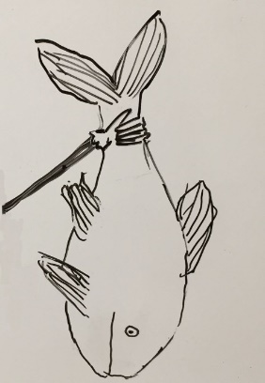

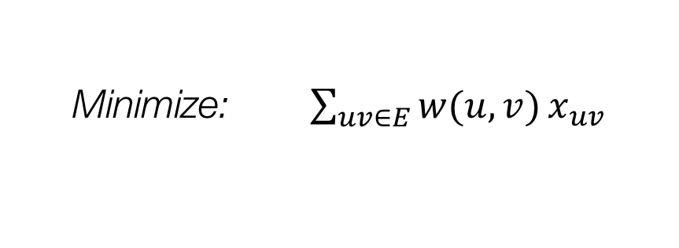
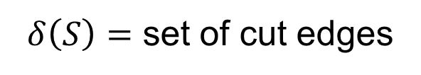
Asymmetric Traveling Salesman Problem
Input: an edge-weighted digraph $G=(V,E,w)$
Output: a minimum-weight connected Eulerian multigraph $(V, E’)$
Variables: $x_{uv}$ = #times we traverse edge$(u,v)$
in-degree = out-degree
Minimize: $\sum_{uv∈E}{w(u,v)}x_{uv}$
$δ\left(S\right)=$ set of cut edges
Subject to: $x\left(δ^{+}\left(v\right)\right)=x(δ^{−}\left(v\right))$ for all $v∈V$
$x\left(δ\left(S\right)\right)≥2$ for all $S⊂V$
S
$x≥0$

Slide 11
Integrality gap of the ?
i.e. how far off is that particular algorithm?

Slide 12
Two natural approaches: begin with…
Output: a minimum-weight connected Eulerian multigraph

Slide 13

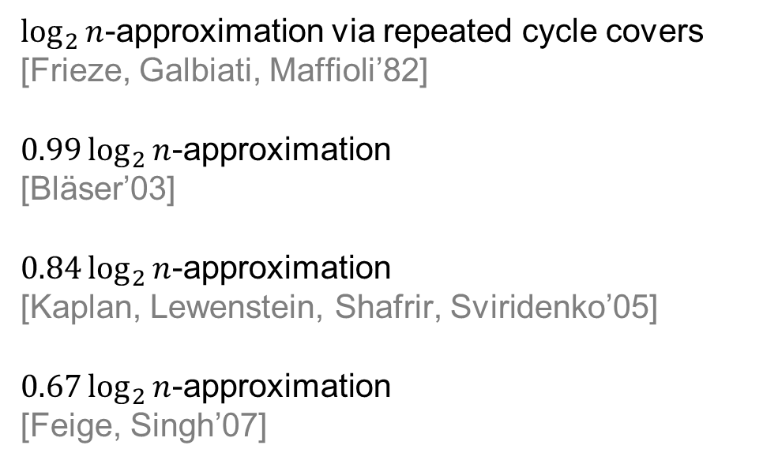
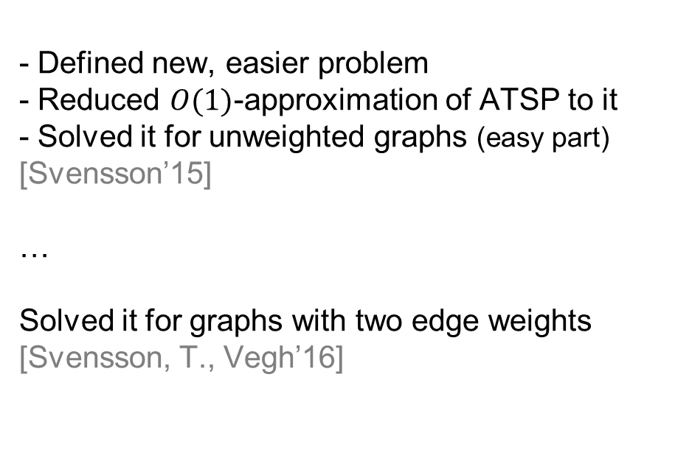
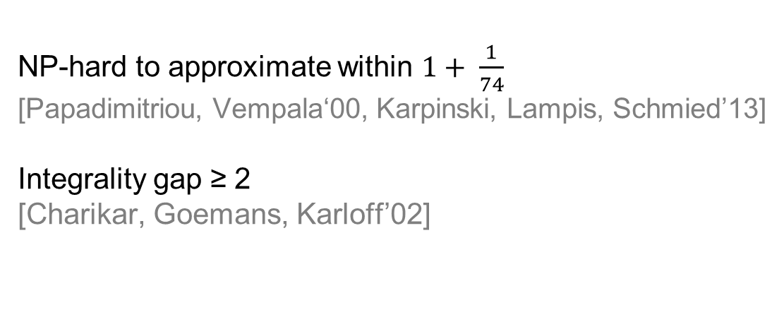
Add Eulerian graphs
until connected
Start with spanning tree,
then make Eulerian
$O(\log{n}/\log{\log{n)}}$-approximation via thin trees
[Asadpour, Goemans, Mądry, Oveis Gharan, Saberi’10]
$O(1)$-approximation for planar & bounded-genus graphs [Oveis Gharan, Saberi’11]
Integrality gap ≤ $poly(log{\log{n}})$
via generalization of Kadison-Singer
[Anari, Oveis Gharan’14]
$\log_{2}{n}$-approximation via repeated cycle covers
[Frieze, Galbiati, Maffioli’82]
$0.99\log_{2}{n}$-approximation
[Bläser’03]
$0.84\log_{2}{n}$-approximation
[Kaplan, Lewenstein, Shafrir, Sviridenko’05]
$0.67\log_{2}{n}$-approximation
[Feige, Singh’07]
Local-Connectivity ATSP
Hardness
- Defined new, easier problem
- Reduced $O(1)$-approximation of ATSP to it
- Solved it for unweighted graphs (easy part)
[Svensson’15]
…
Solved it for graphs with two edge weights
[Svensson, T., Vegh’16]
NP-hard to approximate within $1+ \frac{1}{74}$
[Papadimitriou, Vempala‘00, Karpinski, Lampis, Schmied’13]
Integrality gap ≥ 2
[Charikar, Goemans, Karloff’02]

Slide 14
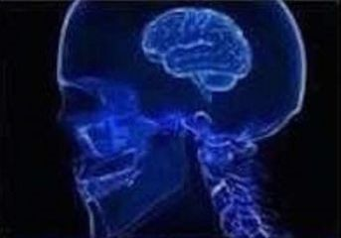
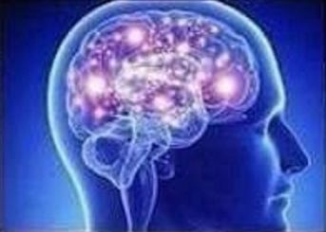
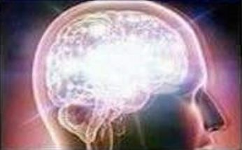
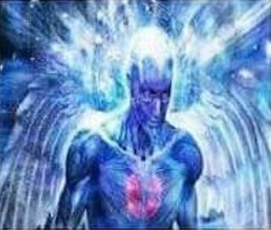
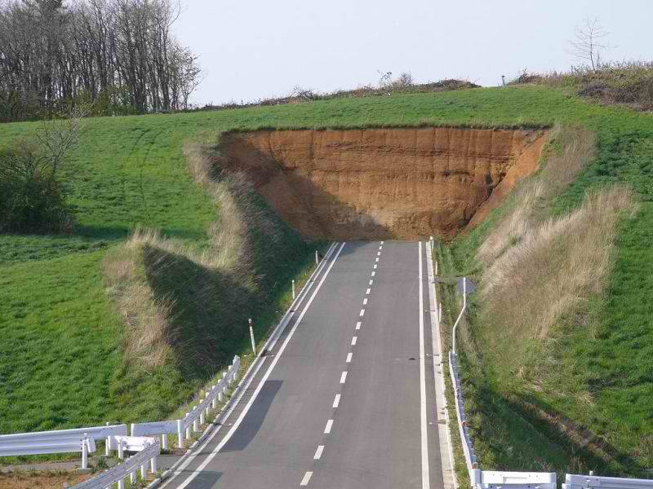
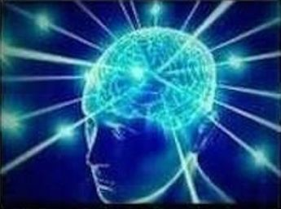
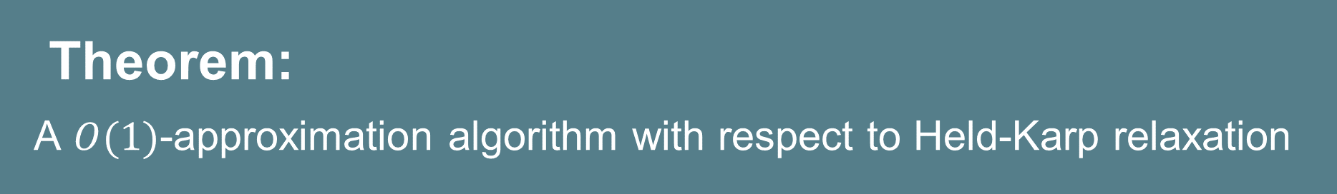
Theorem:
A $O(1)$-approximation algorithm with respect to Held-Karp relaxation
2-edge-weights
ATSP
general
ATSP
structured
ATSP
this talk
[Svensson’15]
[Svensson’15]
2-edge-weights
Local-Connectivity ATSP
general
Local-Connectivity ATSP
more structured
ATSP
Solve
[Svensson, T., Vegh’16]
really structured
Local-Connectivity ATSP
really structured
ATSP
[Svensson’15]
Solve
Notes:
We will give a path of reductions
Looks like a long path, but it is modular, so you can TAKE BREAKS

Slide 15
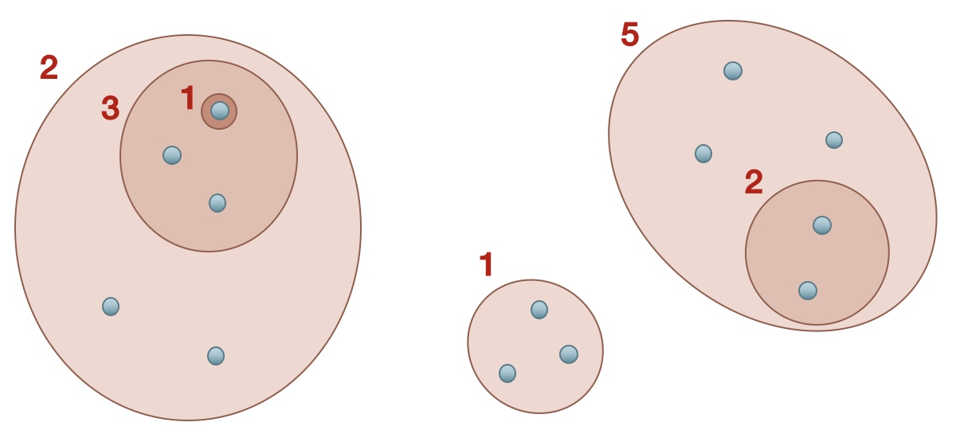
Today, two major ideas:
Get weight functions that are not arbitrary but come from a laminar structure
Can make progress by recursing,
as long as LP-value drops
weight=1+3+2+5
weight=2+5+1

Slide 16
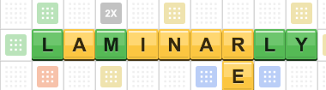
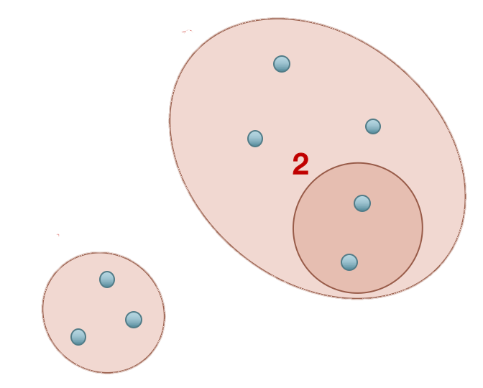
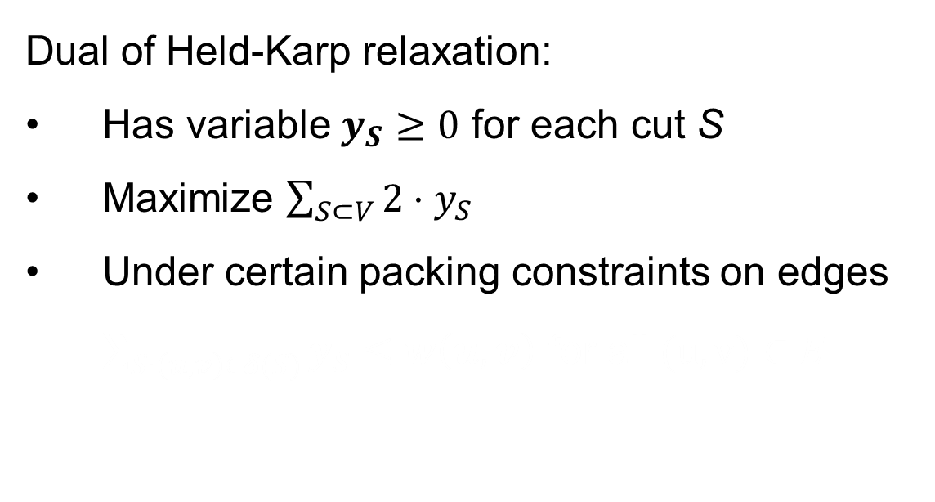
Laminarly-weighted instances
via LP duality
Dual of Held-Karp relaxation:
Has variable $y_{S}≥0$ for each cut S
Maximize $\sum_{S⊂V}{2⋅y_{S}}$
Under certain packing constraints on edges
$\sum_{S:\left(u,v\right)∈δ(S)}{y_{S}}≤w\left(u,v\right)$ for all $(u,v)∈E$
5
1
4
2
3
2
3
1
Complementary slackness + uncrossing + some rewriting yields…

Slide 17

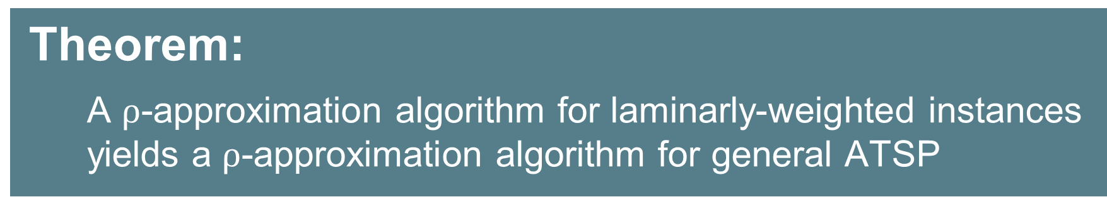
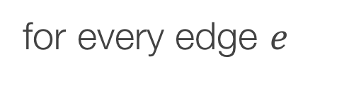
Laminarly-weighted
weight=1+3+2+5
Laminarly-weighted instance $ℐ=(G,x, y)$:
$x,y:$ primal, dual solutions
$y_{}$supported on a laminar family of tight sets (LP says that we should visit each such set once)
weights induced by $y$:
$$w\left(e\right)=\sum_{S:e∈δ(S)}{y_{S}}$$
weight=2+5+1
for every edge $e$
No two sets intersect
non-trivially
Held-Karp lower bound = OPT = $2⋅\sum_{S}{y_{S}}$
Theorem:
      A $ρ$-approximation algorithm for laminarly-weighted instances
      yields a $ρ$-approximation algorithm for general ATSP

Slide 18
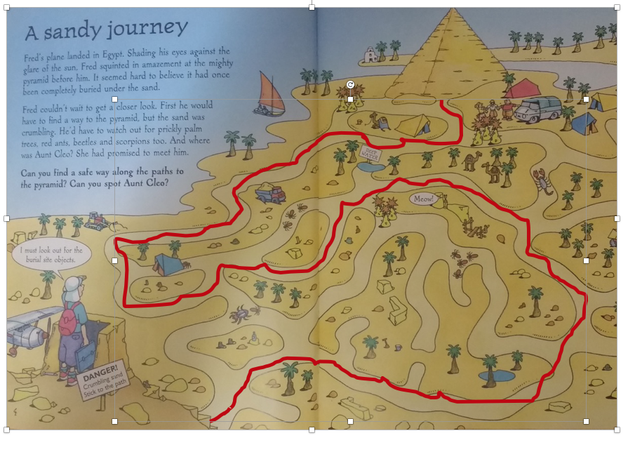
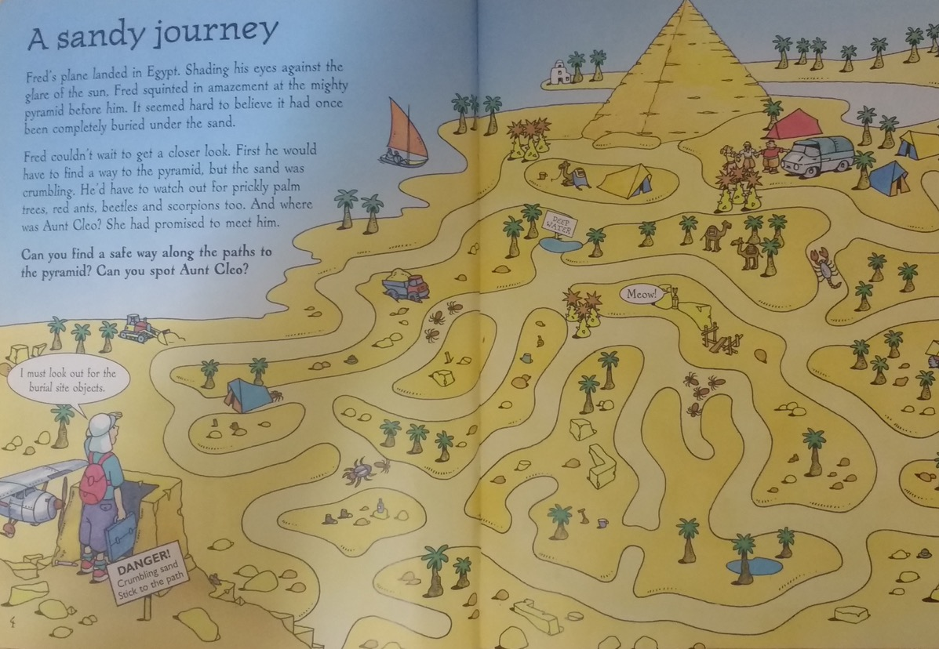
Basic idea:
recursively solving smaller instances
is not dangerous
if optimum drops
Irreducible instances

Slide 19
Let’s take a detour

Slide 20
Repeated cycle cover
Find min-cost cycle cover
“Contract“
Repeat until graph is connected
[Frieze, Galbiati, and Maffioli’82]

Slide 21

Repeated cycle cover
Find min-cost cycle cover
“Contract“
Repeat until graph is connected
[Frieze, Galbiati, and Maffioli’82]
Cost of cycle cover $≤OPT$

Slide 22
Repeated cycle cover
Find min-cost cycle cover
“Contract“
Repeat until graph is connected
[Frieze, Galbiati, and Maffioli’82]
Cost of cycle cover $≤OPT$

Slide 23

Repeated cycle cover
Find min-cost cycle cover
“Contract“
Repeat until graph is connected
[Frieze, Galbiati, and Maffioli’82]
Cost of cycle cover $≤OPT$
Cost of cycle cover $≤OPT$

Slide 24
Repeated cycle cover
Find min-cost cycle cover
“Contract“
Repeat until graph is connected
[Frieze, Galbiati, and Maffioli’82]
Cost of cycle cover $≤OPT$
Cost of cycle cover $≤OPT$

Slide 25

Repeated cycle cover
Find min-cost cycle cover
“Contract“
Repeat until graph is connected
[Frieze, Galbiati, and Maffioli’82]
Cost of cycle cover $≤OPT$
Cost of cycle cover $≤OPT$
Cost of cycle cover $≤OPT$

Slide 26


Repeated cycle cover
Find min-cost cycle cover
“Contract“
Repeat until graph is connected
[Frieze, Galbiati, and Maffioli’82]
Worst case: all cycles have length 2 so need to repeat $\log_{2}{n}$ times (each time cost $OPT_{LP})$
Cost of cycle cover $≤OPT$
Cost of cycle cover $≤OPT$
Cost of cycle cover $≤OPT$
Total cost $≤3⋅OPT$
$\log_{2}{n}$-approximation

Slide 27

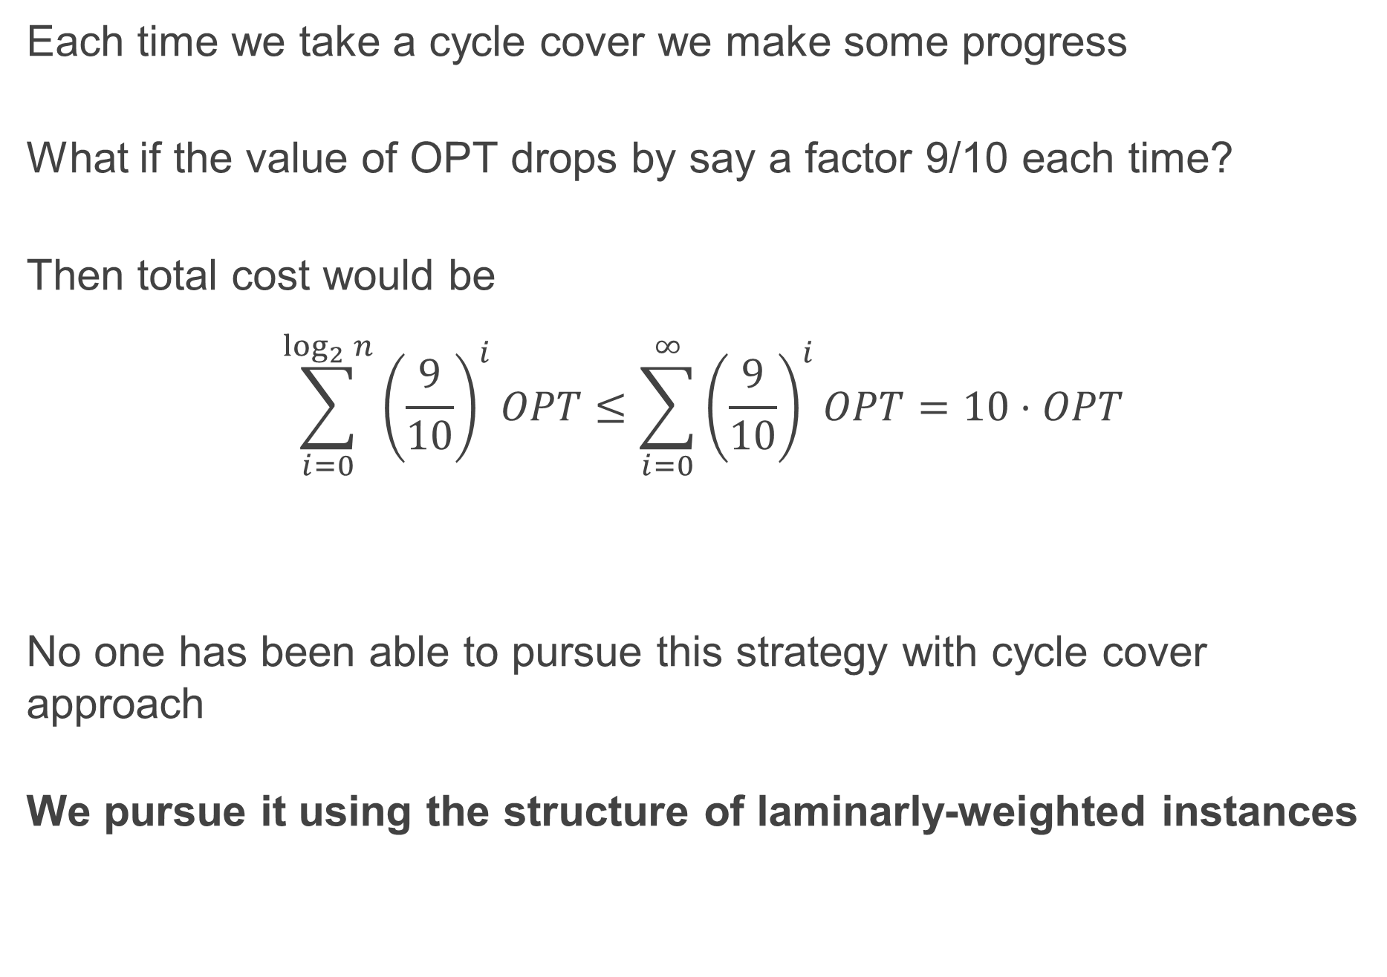
Recursive algorithm fine if value drops
Each time we take a cycle cover we make some progress
What if the value of OPT drops by say a factor 9/10 each time?
Then total cost would be
$$\sum_{i=0}^{\log_{2}{n}}{{\left(\frac{9}{10}\right)}^{i}OPT}≤\sum_{i=0}^{∞}{{\left(\frac{9}{10}\right)}^{i}OPT=10⋅OPT}$$
No one has been able to pursue this strategy with cycle cover approach
We pursue it using the structure of laminarly-weighted instances
Notes:
Then you would be happy and you can write your paper ☺

Slide 28
Le retour
Notes:
Now a second wordplay from Ola

Slide 29
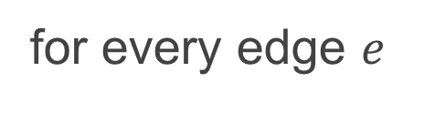
weight=1+3+2+5
Laminarly-weighted
Laminarly-weighted instance $ℐ=(G,x, y)$:
$x,y:$ primal, dual solutions
$y_{}$supported on a laminar family of tight sets (LP says that we should visit each such set once)
weights induced by $y$:
$$w\left(e\right)=\sum_{S:e∈δ(S)}{y_{S}}$$
weight=2+5+1
for every edge $e$

Slide 30
Key idea: recursive approach
via contracting laminar sets

Slide 31
Contraction of tight sets
2
6
1
2
5
1
4
2
3
2
7
3
1

Slide 32

Contraction of tight sets
2
6
2
6
1
1
2
2
5
1
4
2
?
3
2
7
3
7
3
1
1
Contraction gives smaller instance: G, x easy to contract
Remains to specify y-value of new vertex/set

Slide 33
Lifting a tour in the contracted instance
2
6
2
6
1
1
2
2
5
1
4
2
?
3
2
7
3
7
3
1
1

Slide 34
Lifting a tour in the contracted instance
2
6
2
6
1
1
2
2
5
1
4
2
?
3
2
7
3
7
3
1
1
What to do?
Lift tour in contracted instance to subtour in original instance

Slide 35
Lifting a tour in the contracted instance
2
6
2
6
1
1
2
2
Set so that we always pay for the rewiring in lift
5
1
4
2
?
3
2
7
3
7
3
1
1
What to do?
Simply add a shortest path
Lift tour in contracted instance to subtour in original instance

Slide 36
2
6
2
6
1
1
2
2
Set so that we always pay for the rewiring in lift
5
1
4
2
?
3
Set y-value of new set to pay for
maximum cost over all possible ways to enter and exit the original set
2
7
3
7
3
1
1

Slide 37
2
6
2
6
1
1
2
2
Set so that we always pay for the rewiring in lift
5
1
4
2
17
?
3
2
7
3
7
3
1
1
Set y-value of new set to pay for
maximum cost over all possible ways to enter and exit the original set
In example:
? = 5+2+2+1+4+3 = 17 (path crosses every tight set)
Fact: This is the worst case. So contraction does not increase LP-value
Def: Set is reducible if contraction decreases LP-value a lot

Slide 38
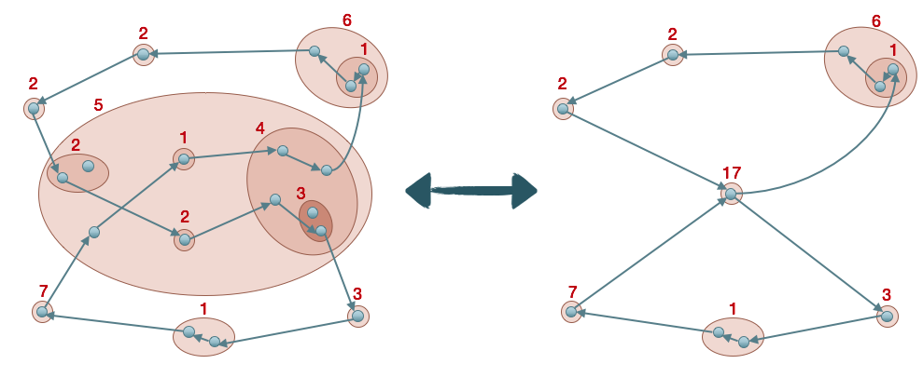
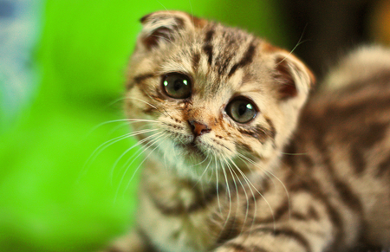
Facts about contraction
Fact: Lift no more expensive than tour in contracted instance (by design)
So are we done?
Negative fact: Lift is a subtour but may not be a tour:
it visits all vertices outside contracted set but not inside
Def: Set is reducible if contraction decreases LP-value a lot
Then we can use remaining budget to complete the lift into tour!

Slide 39
Implementing recursive strategy

Slide 40

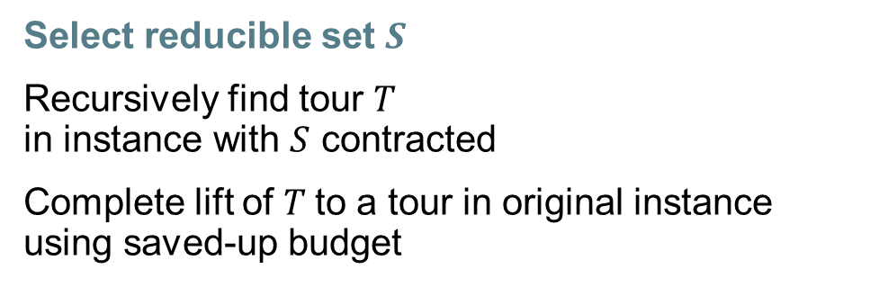
Alg if ∃ reducible set S
Select reducible set $S$
Recursively find tour $T$
in instance with $S$ contracted
Complete lift of $T$to a tour in original instance using saved-up budget
2
6
2
6
1
1
2
$S$:reducible set
2
5
1
4
2
14
3
2
7
3
7
3
1
1

Slide 41
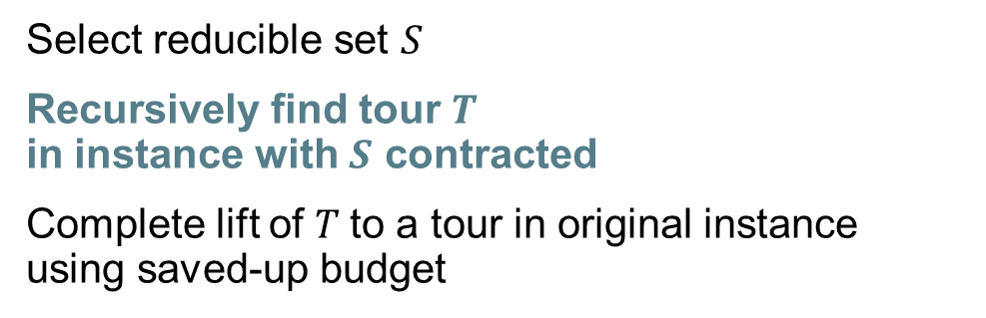
Alg if ∃ reducible set S
Select reducible set $S$
Recursively find tour $T$
in instance with $S$ contracted
Complete lift of $T$to a tour in original instance using saved-up budget
2
6
2
6
1
1
2
$S$:reducible set
2
5
1
4
2
14
3
2
7
3
7
3
1
1
Recursive call returns $α$-approximate solution $T$ on smaller instance:
$$w\left(T\right)≤α\left(OPT −drop\right)=α∙OPT−budget$$

Slide 42

Alg if ∃ reducible set S
Select reducible set $S$
Recursively find tour $T$
in instance with $S$ contracted
Complete lift of $T$to a tour in original instance using saved-up budget
2
6
2
6
1
1
2
$S$:reducible set
2
5
1
4
2
14
3
2
7
3
7
3
1
1
Recursive call returns $α$-approximate solution $T$ on smaller instance:
$$w\left(T\right)≤α\left(OPT −drop\right)=α∙OPT−budget$$
$$w\left(lift\right)≤$$

Slide 43


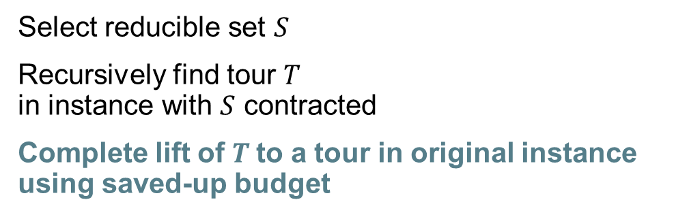
Alg if ∃ reducible set S
Select reducible set $S$
Recursively find tour $T$
in instance with $S$ contracted
Complete lift of $T$to a tour in original instance using saved-up budget
2
6
2
6
1
1
2
$S$:reducible set
2
5
1
4
2
14
3
2
7
3
7
3
1
1
Recursive call returns $α$-approximate solution $T$ on smaller instance:
$$w\left(T\right)≤α\left(OPT −drop\right)=α∙OPT−budget$$
$$w\left(lift\right)≤$$
Finally: complete lift to a tour using $budget$, again via a recursive call
$$w\left(completion\right)≤budget$$
$$w\left(lift+ completion\right)≤α∙OPT$$
We return $α$-approximate solution on entire instance

Slide 44
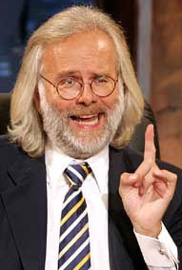
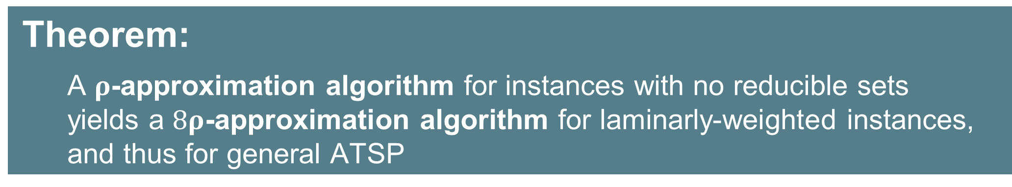
Theorem:
      A $ρ$-approximation algorithm for instances with no reducible sets
      yields a $8ρ$-approximation algorithm for laminarly-weighted instances,
      and thus for general ATSP

Slide 45

general
ATSP
laminarly-weighted
ATSP
irreducible
ATSP
What about instances
with no reducible sets?

Slide 46
Def: Set is reducible if contraction decreases LP-value a lot
sum = 17
Length of longest
shortest path inside, roughly
1
4
2
16
3
2
Small decrease → Long path inside
What about instances
with no reducible sets?
(useful! almost Hamiltonian)

Slide 47
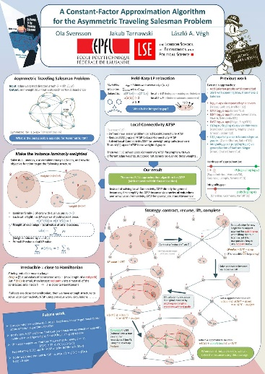
The rest of the story
10-page version of paper with main ideas
Recorded talks
Talk to me
at the poster session!

Slide 48

Summary and open problems…

Slide 49
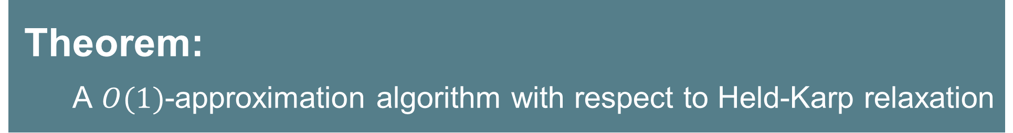
Theorem:
      A $O(1)$-approximation algorithm with respect to Held-Karp relaxation

Slide 50
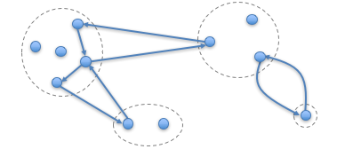
Sequence of reductions
Amazing power of LP-duality
Laminarly-weighted instances
Recursive approach as long as OPT drops
Irreducible instances
Irreducible instances behave like node-weighted
Vertebrate pairs
Complete backbone to tour using circulations and Local-Connectivity ATSP
Solving Local-Connectivity
Notes:
We get 5500
It’s modular
Could get a couple of hundreds by losing this modularity and specializing each part, but that would make the paper a lot more complicated
But definitely need new ideas to get close to 2 - you can’t lose a constant in every part of this if you want to get 2…

Slide 51
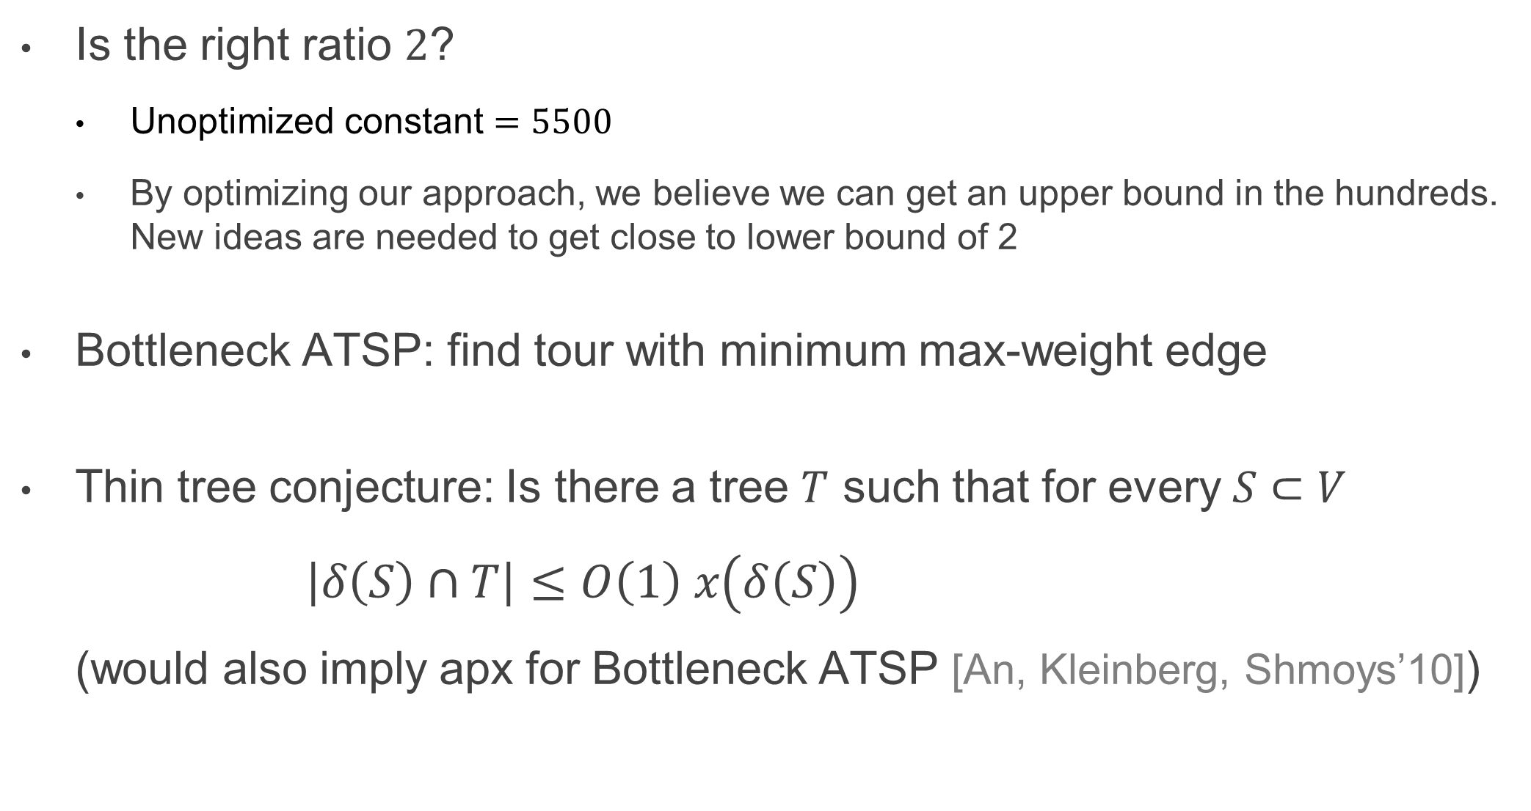
Open questions
Is the right ratio $2$?
  Unoptimized constant $=5500$
  By optimizing our approach, we believe we can get an upper bound in the hundreds. New ideas are needed to get close to lower bound of 2
Bottleneck ATSP: find tour with minimum max-weight edge
Thin tree conjecture: Is there a tree $T$ such that for every $S⊂V$ $\left|δ\left(S\right)∩T\right|≤O\left(1\right) x\left(δ\left(S\right)\right)$
(would also imply apx for Bottleneck ATSP [An, Kleinberg, Shmoys’10])
Thank you!
Notes:
Bottleneck: for symmetric, 2 is tight and known for a long time
Thin tree => constant for bottleneck ATSP

