Slide 1
Hierarchy-Based Algorithms for Minimizing Makespan under Precedence and Communication Constraints
Janardhan Kulkarni Shi Li Jakub Tarnawski Minwei Ye
Microsoft Research University at Buffalo
08.01.2020 SODA

Slide 2



Scheduling with precedence constraints
$n$ jobs
  job $j$ has processing time (size) $p_{j}$
$m$ identical machines
partial order $≺$
2
4
1
3
makespan
1
2
What is the approximability of this problem?
$$p_{1}$$
3
4

Slide 3

Graham (‘66): 2-approximation
Whenever a machine is idle, run any available job on it
  Greedy
  List Scheduling
Makespan $≤$ OPT + max length of a chain $≤2⋅$ OPT

Slide 4

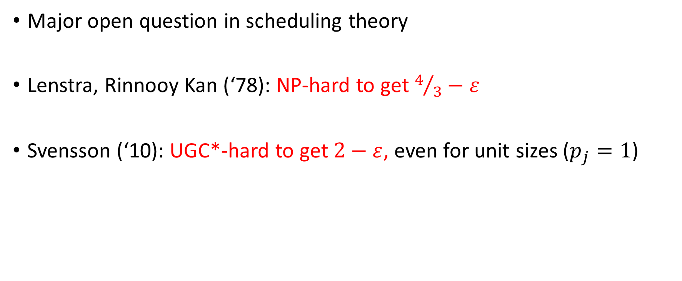
Can one beat 2?
Major open question in scheduling theory
Lenstra, Rinnooy Kan (‘78): NP-hard to get $4/3−ε$
Svensson (‘10): UGC*-hard to get $2−ε$, even for unit sizes ($p_{j}=1$)
What if $m = O(1)$?
rest
of the
talk
For many applications in practice this is OK.

Slide 5

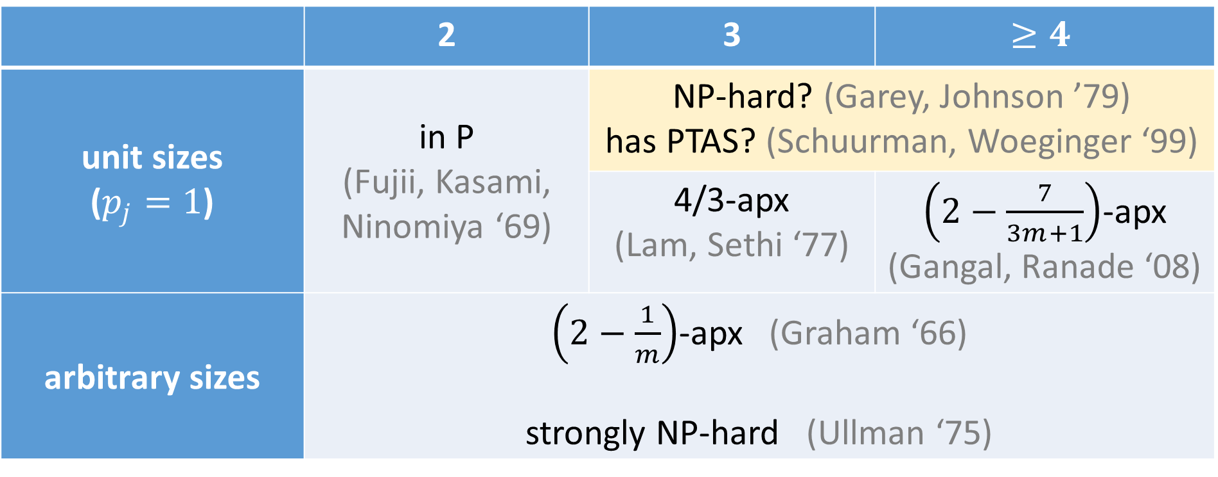
What if $m = O(1)$?
 | 2 | 3 | $$≥4$$
unit sizes ($p_{j}=1$) | in P (Fujii, Kasami, Ninomiya ‘69) | NP-hard? (Garey, Johnson ’79) has PTAS? (Schuurman, Woeginger ‘99)
 |  | 4/3-apx (Lam, Sethi ‘77) | $\left(2−\frac{7}{3m+1}\right)$-apx (Gangal, Ranade ‘08)
arbitrary sizes | $\left(2−\frac{1}{m}\right)$-apx (Graham ‘66) strongly NP-hard (Ullman ‘75)
Levey, Rothvoss (‘16)
Notes:
Poor understanding. Everything that we know, we know from the ‘70s…

Slide 6

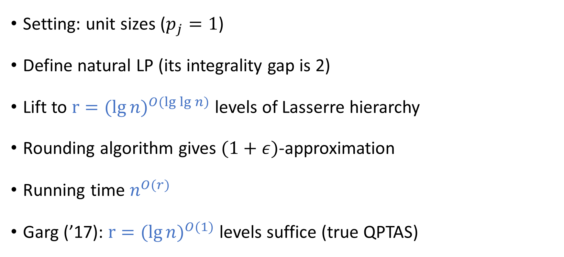
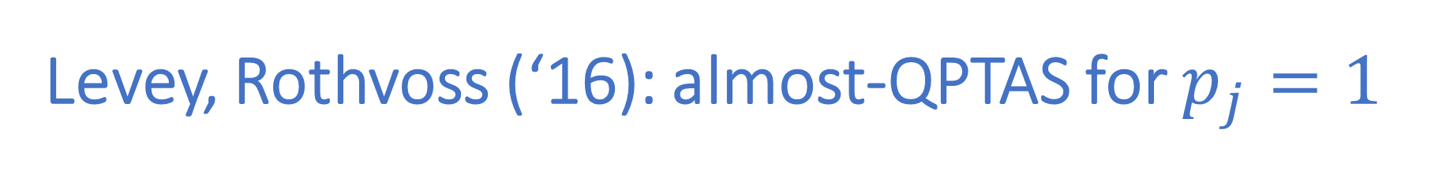
Levey, Rothvoss (‘16): almost-QPTAS for $p_{j}=1$
Setting: unit sizes ($p_{j}=1$)
Define natural LP (its integrality gap is 2)
Lift to ${r=(lg{n)}}^{O(lg{\lg{n})}}$ levels of Lasserre hierarchy
Rounding algorithm gives $(1+ε)$-approximation
Running time $n^{O(r)}$
Garg (’17): ${r=(lg{n})}^{O(1)}$ levels suffice (true QPTAS)
“A tantalizing question is whether a similar approach
could give a (1 + ε)-approximation for the setting where the processing times are arbitrary”

Slide 7
Arbitrary sizes
Can Levey-Rothvoss be generalized?
Three possible settings:
Fully preemptive
Preemptive but non-migratory
Non-preemptive
OPTs can be constant-factor away from each other

Slide 8


Arbitrary sizes
Can Levey-Rothvoss be generalized?
Three possible settings:
Fully preemptive
YES, this is simply equivalent to unit sizes:
$$p_{j}=5$$

Slide 9
Arbitrary sizes
Can Levey-Rothvoss be generalized?
Three possible settings:
Fully preemptive
Preemptive but non-migratory
Our main result: YES (almost-QPTAS)

Slide 10
Arbitrary sizes
Can Levey-Rothvoss be generalized?
Three possible settings:
Fully preemptive
Preemptive but non-migratory
Non-preemptive
Our result: some evidence the lifted LP might be weak
(even for 2 machines)

Slide 11






Communication delays
If $j≺j’$ are scheduled on different machines, need to wait $c_{j,j′}$
$$j$$
$$j’$$
$$j’$$
$$j$$
$$c_{j,j′}$$
Notes:
Introduced by Papadimitriou and Yannakakis, and Veltman et al., in the ’80s

Slide 12


Communication delays
If $j≺j’$ are scheduled on different machines, need to wait $c_{j,j′}$
Highly relevant to practice
No good LP/SDP relaxations known
Hanen, Munier (‘01): 7/3-apx for unit sizes ($p_{j}=1$), unit delays ($c_{j,j′}$ = 1)
Bansal (‘17):
“Not understood at all. Almost completely open.”
Our result: almost-QPTAS if $c_{j,j′}≤O(1)$
Arbitrary sizes (preemptive but non-migratory)
Notes:
The communication delays can be different

Slide 13

Outline of the rest of talk
Our main result: almost-QPTAS for
preemptive but non-migratory setting
Levey-Rothvoss framework
Challenges of arbitrary sizes
Our new ideas

Slide 14


Graham (‘66): 2-approximation
Whenever a machine is idle, run any available job on it
Makespan $≤$ OPT + max length of a chain $≤2⋅$ OPT
Crucial idea: get $(1+ε)$-apx if longest chain $≤ε⋅OPT$
Use LP hierarchy to cut long chains

Slide 15


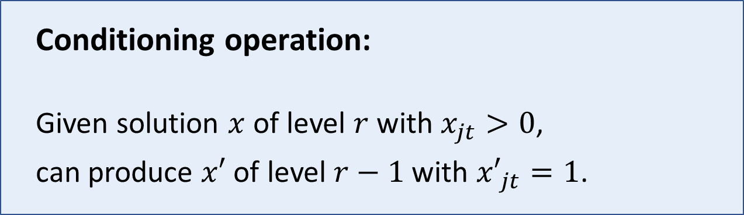
Hierarchy as black box
We have $x_{jt}=1$ meaning: job $j$ should be scheduled at time $t$.
Conditioning operation:
Given solution $x$ of level $r$ with $x_{jt}>0$,
can produce $x′$ of level $r−1$ with ${x′}_{jt}=1$.
Can fix an integral timeslot $t$ for job $j$ by “paying 1 level”.

Slide 16

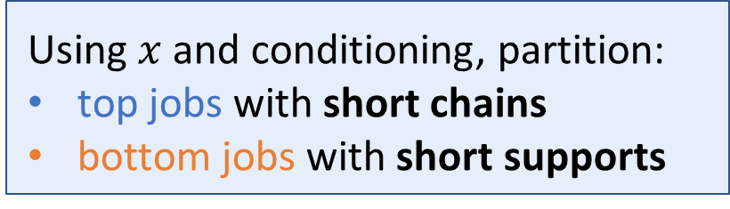




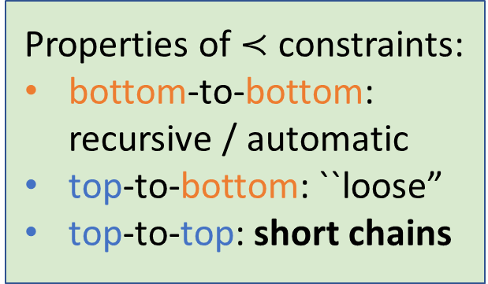
Levey-Rothvoss framework
Using $x$ and conditioning, partition:
top jobs with short chains
bottom jobs with short supports
top jobs
Recursively schedule bottom jobs
Algorithm to add top jobs to schedule
bottom jobs
Properties of $≺$constraints:
bottom-to-bottom:
recursive / automatic
top-to-bottom: ``loose”
top-to-top: short chains
$$0$$
$$T_{1}$$
$$T_{2}$$
$$T_{3}$$
$$T$$
EDF (Earliest Deadline First) scheduling does the trick
Notes:
Use the conditioning operation to break up chains
A special scheduling problem with release times and deadlines

Slide 17
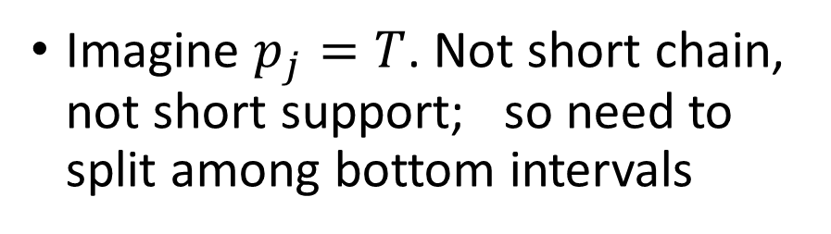
Challenges of arbitrary sizes
Using $x$ and conditioning, partition:
top jobs with short chains
bottom jobs with short supports
Why not just do this?
big-job
small-jobs
Imagine $p_{j}=T$. Not short chain, not short support; so need to split among bottom intervals
But then, no control: small-jobs could go to different machines
Notes:
They are scheduled independently

Slide 18
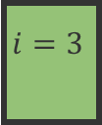
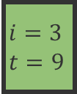
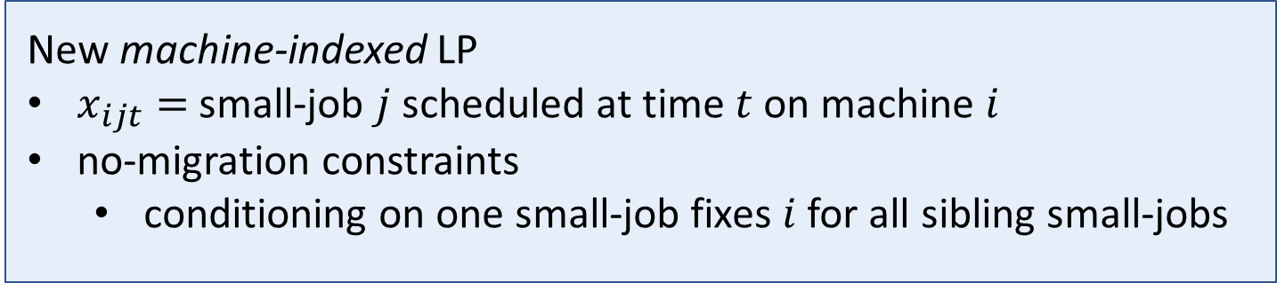
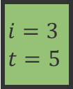
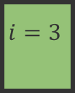
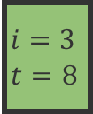
Our ideas
New machine-indexed LP
$x_{ijt}=$ small-job $j$ scheduled at time $t$ on machine $i$
no-migration constraints
  conditioning on one small-job fixes $i$ for all sibling small-jobs
Special treatment of conditioned jobs:
new splitting operation
they are always pushed down to bottom of recursion, and there scheduled solely using LP
  guarantees correct machine assignment
$$i=3$$
$$i=3 \\ t=5$$
$$i=3$$
$$i=3$$
$$t=8$$
$$i=3$$
$$t=9$$

Slide 19






Adding top jobs to schedule
$$0$$
$$T_{1}$$
$$T_{2}$$
$$T_{3}$$
$$T$$
sibling small-jobs?
Levey-Rothvoss (unit sizes):
EDF (Earliest Deadline First) scheduling does the trick
New algorithm to schedule top jobs:
treat big-jobs together
to choose job: EDF (Earliest Deadline First)
  to choose machine: ECT (Earliest Completion Time)
But it creates a migratory schedule!

Slide 20

Summary
+ a few words on our hardness result

Slide 21
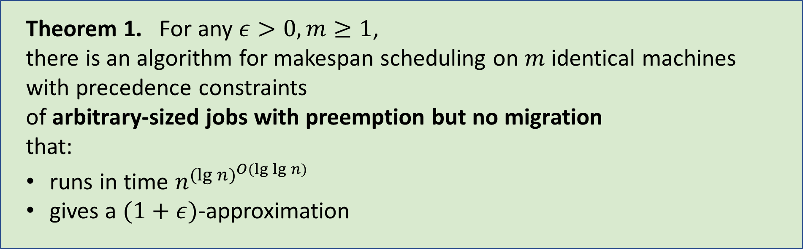
Our results (1/3)
Theorem 1. For any $ε>0,m≥1$,
there is an algorithm for makespan scheduling on $m$ identical machines
with precedence constraints
of arbitrary-sized jobs with preemption but no migration
that:
runs in time $n^{{(\lg{n)}}^{O(\lg{\lg{n)}}}}$
gives a $(1+ε)$-approximation

Slide 22
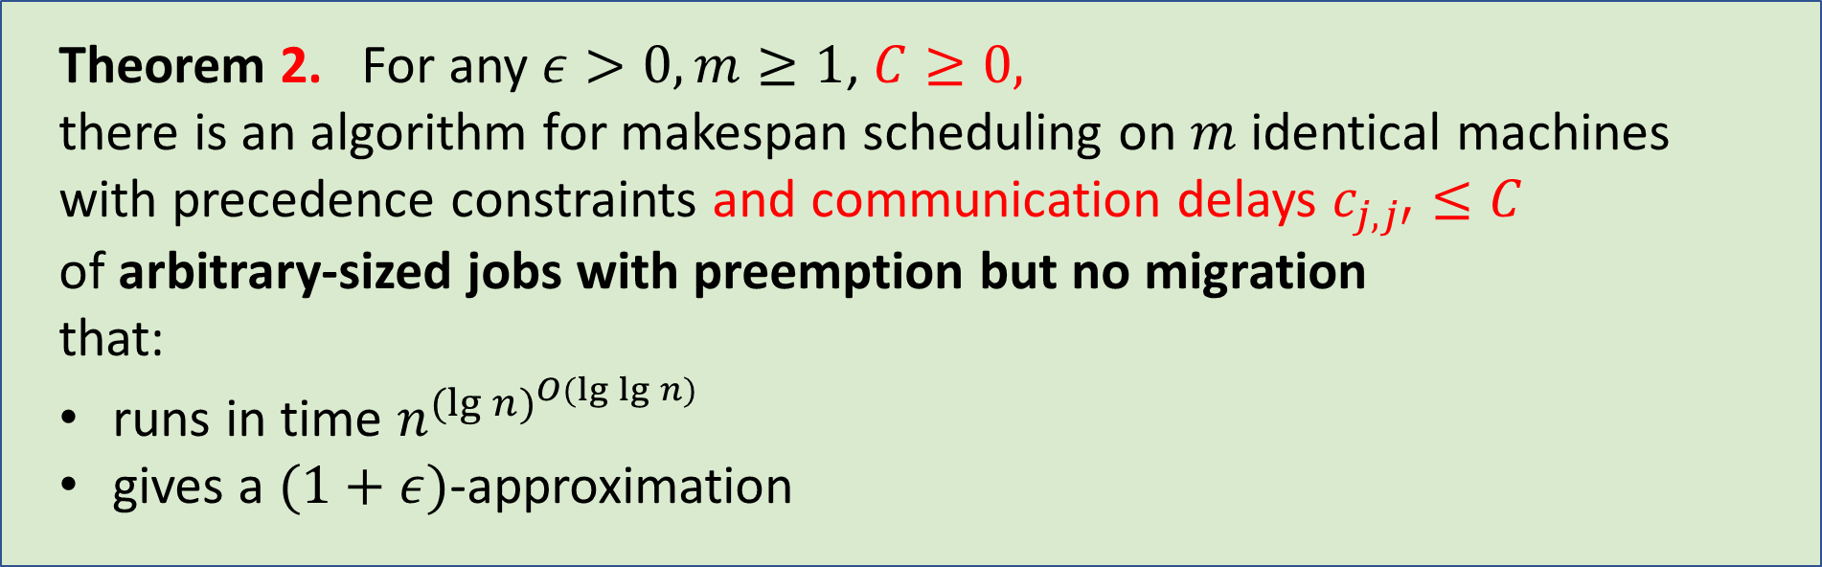
Our results (2/3)
Theorem 2. For any $ε>0,m≥1$, $C≥0,$
there is an algorithm for makespan scheduling on $m$ identical machines
with precedence constraints and communication delays $c_{j,j′}≤C$
of arbitrary-sized jobs with preemption but no migration
that:
runs in time $n^{{(\lg{n)}}^{O(\lg{\lg{n)}}}}$
gives a $(1+ε)$-approximation

Slide 23
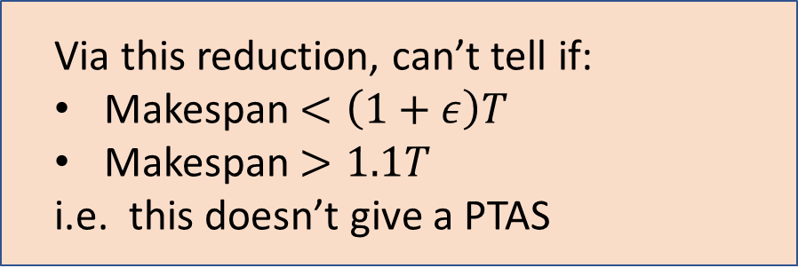
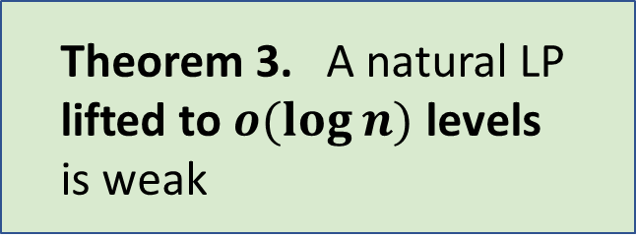
Our results (3/3): evidence of hardness?
A special case of:
2 machines,
arbitrary sizes,
no preemption
A deadline scheduling problem
Theorem 3. A natural LP lifted to $o(\log{n)}$ levels is weak
Via this reduction, can’t tell if:
Makespan $<\left(1+ε\right)T$
Makespan $>1.1T$
i.e. this doesn’t give a PTAS
We can’t reason about the LP for makespan…
but we think our hard instance is the right one

Slide 24
Future work

Slide 25

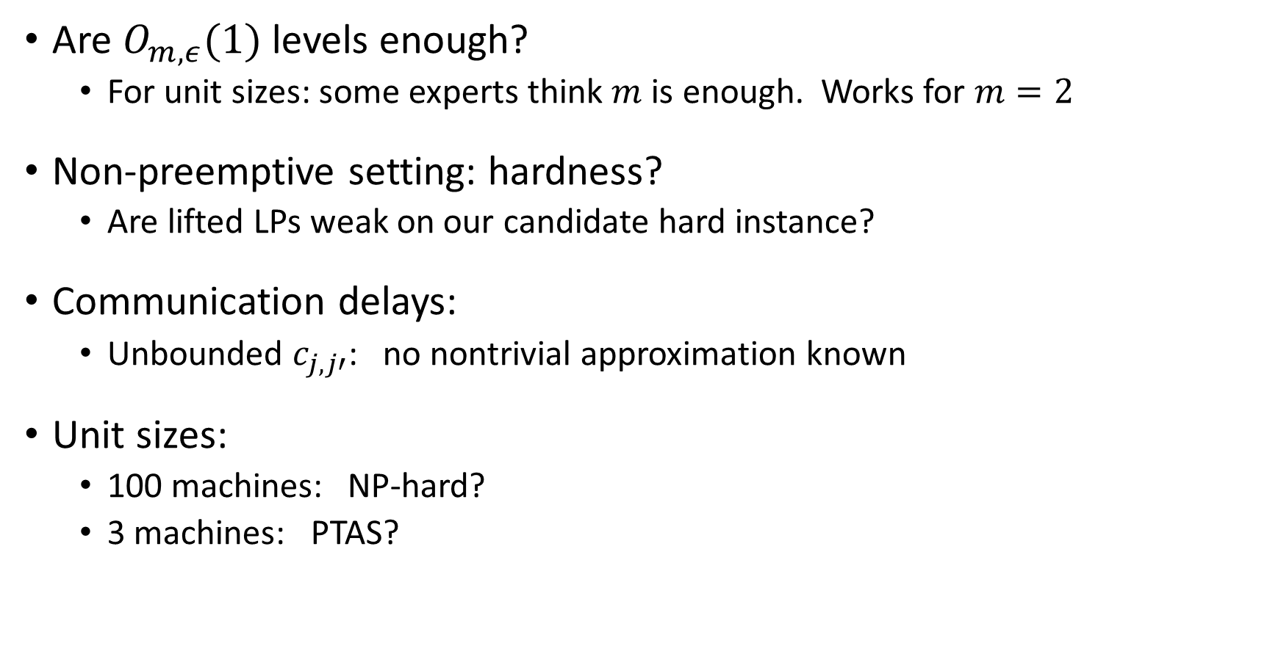
Future work
Are $O_{m,ε}(1)$ levels enough?
  For unit sizes: some experts think $m$ is enough. Works for $m=2$
Non-preemptive setting: hardness?
  Are lifted LPs weak on our candidate hard instance?
Communication delays:
  Unbounded $c_{j,j′}$: no nontrivial approximation known
Unit sizes:
  100 machines: NP-hard?
  3 machines: PTAS?
Thank you!

