Slide 1
Fair Matroid Submodular Maximization
Sherry Sarkar
Joint work with: Sepideh Mahabadi and Jakub Tarnawski

Slide 2
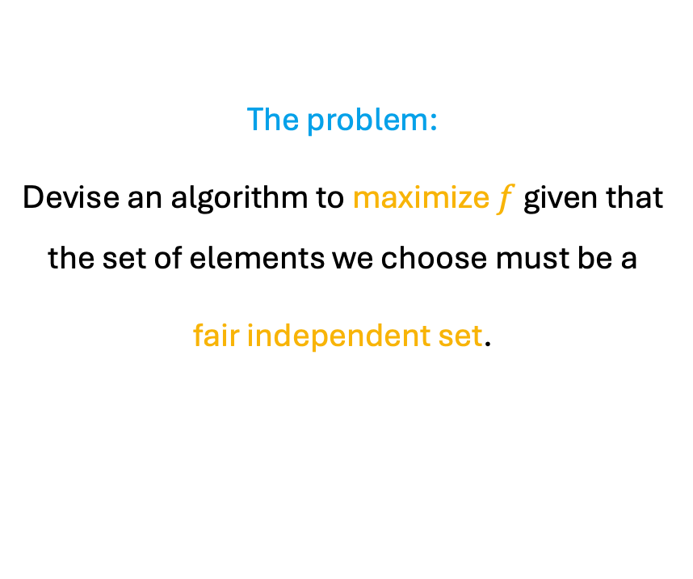
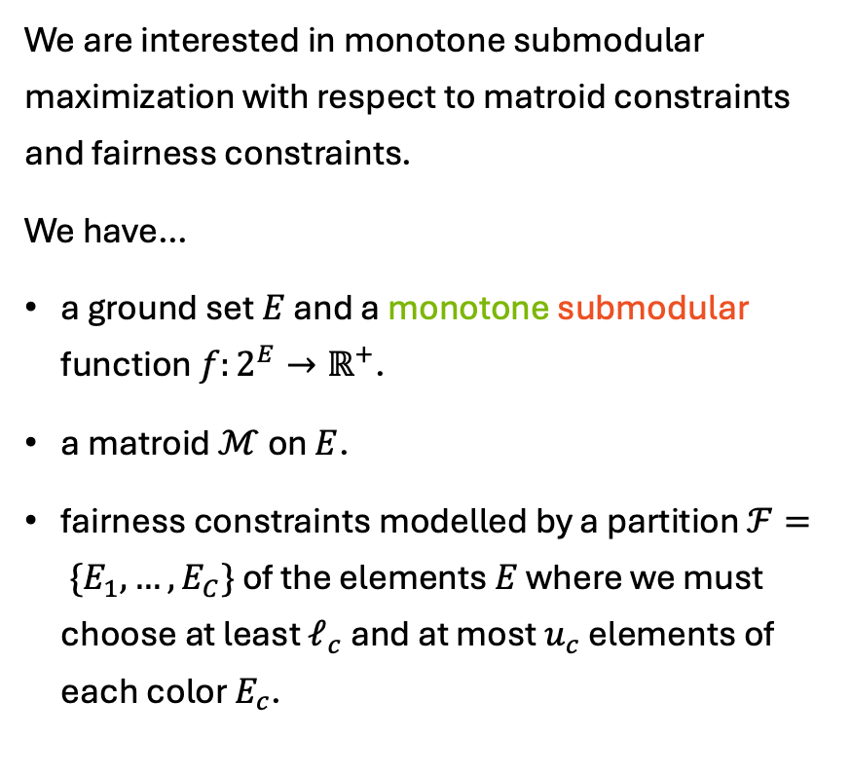
Problem Definition
We are interested in monotone submodular maximization with respect to matroid constraints and fairness constraints.
We have…
a ground set $E$ and a monotone submodular function $f:2^{E}→ℝ^{+}$.
a matroid $ℳ$ on $E$.
fairness constraints modelled by a partition $ℱ= \{E_{1},…, E_{C}\}$ of the elements $E$ where we must choose at least $ℓ_{c}$ and at most $u_{c}$ elements of each color $E_{c}$.
The problem:
Devise an algorithm to maximize $f$ given that the set of elements we choose must be a
fair independent set.

Slide 3
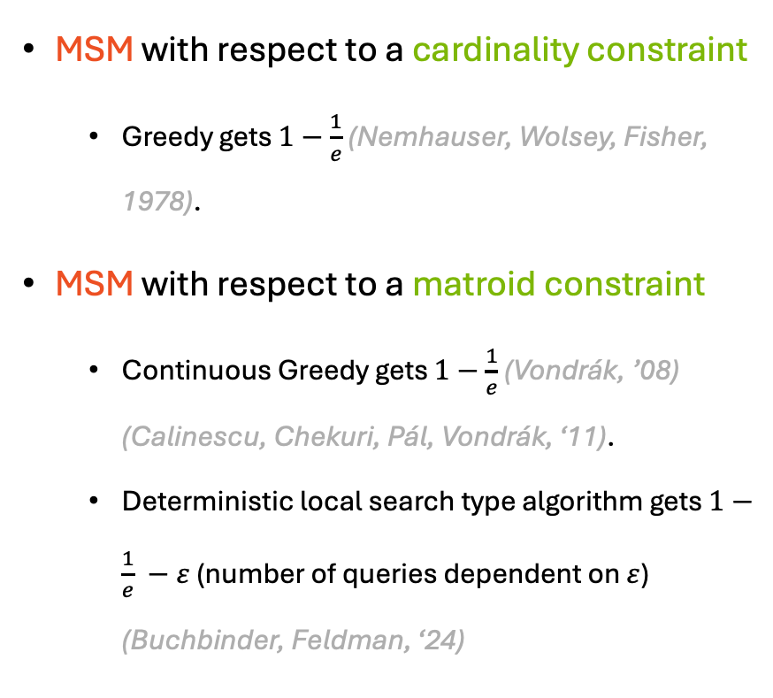
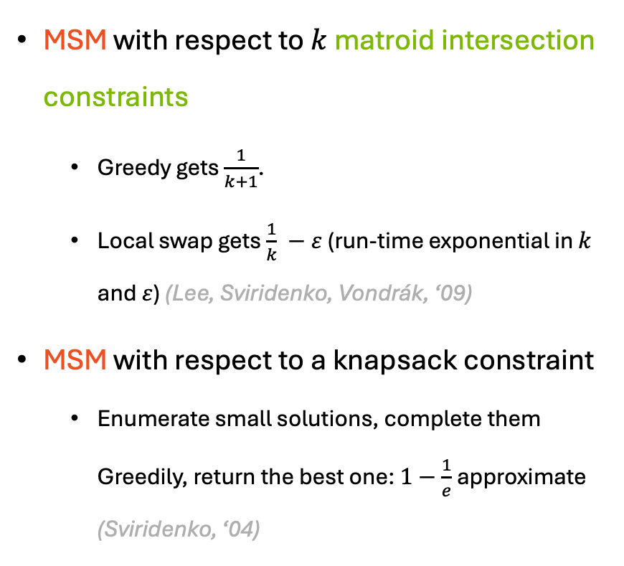
Prior Work
MSM with respect to a cardinality constraint
Greedy gets $1−\frac{1}{e}$ (Nemhauser, Wolsey, Fisher, 1978).
MSM with respect to a matroid constraint
Continuous Greedy gets $1−\frac{1}{e}$ (Vondrák, ’08) (Calinescu, Chekuri, Pál, Vondrák, ‘11).
Deterministic local search type algorithm gets $1−\frac{1}{e} −ε$ (number of queries dependent on $ε$) (Buchbinder, Feldman, ‘24)
MSM with respect to $k$ matroid intersection constraints
Greedy gets $\frac{1}{k+1}$.
Local swap gets $\frac{1}{k} −ε$ (run-time exponential in $k$ and $ε$) (Lee, Sviridenko, Vondrák, ‘09)
MSM with respect to a knapsack constraint
Enumerate small solutions, complete them Greedily, return the best one: $1−\frac{1}{e}$approximate (Sviridenko, ‘04)
Monotone Submodular Maximization
All these constraint sets are downward closed!

Slide 4
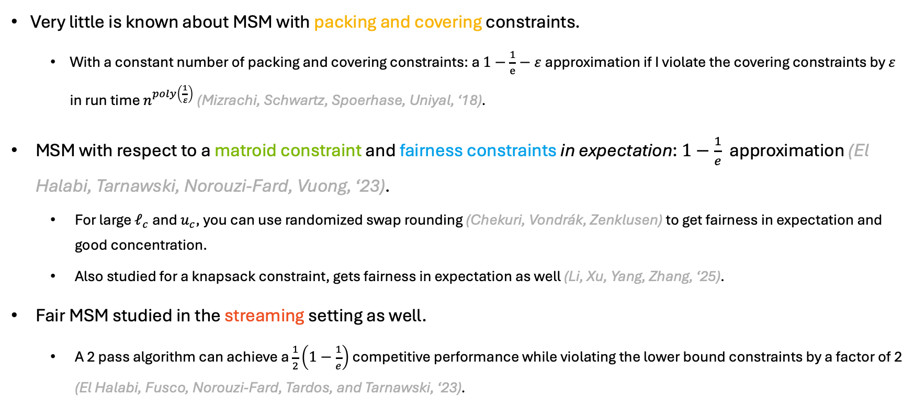
Prior Work
Very little is known about MSM with packing and covering constraints.
With a constant number of packing and covering constraints: a $1−\frac{1}{e}−ε$approximation if I violate the covering constraints by $ε$ in run time $n^{poly\left(\frac{1}{ε}\right)}$ (Mizrachi, Schwartz, Spoerhase, Uniyal, ‘18).
MSM with respect to a matroid constraint and fairness constraints in expectation: $1−\frac{1}{e}$ approximation (El Halabi, Tarnawski, Norouzi-Fard, Vuong, ‘23).
For large $ℓ_{c}$ and $u_{c}$, you can use randomized swap rounding (Chekuri, Vondrák, Zenklusen) to get fairness in expectation and good concentration.
Also studied for a knapsack constraint, gets fairness in expectation as well (Li, Xu, Yang, Zhang, ‘25).
Fair MSM studied in the streaming setting as well.
A 2 pass algorithm can achieve a $\frac{1}{2}\left(1−\frac{1}{e}\right)$ competitive performance while violating the lower bound constraints by a factor of 2 (El Halabi, Fusco, Norouzi-Fard, Tardos, and Tarnawski, ‘23).

Slide 5
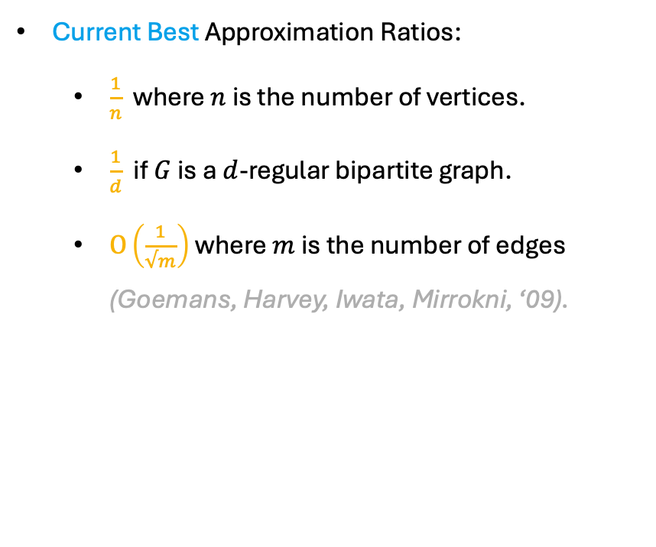
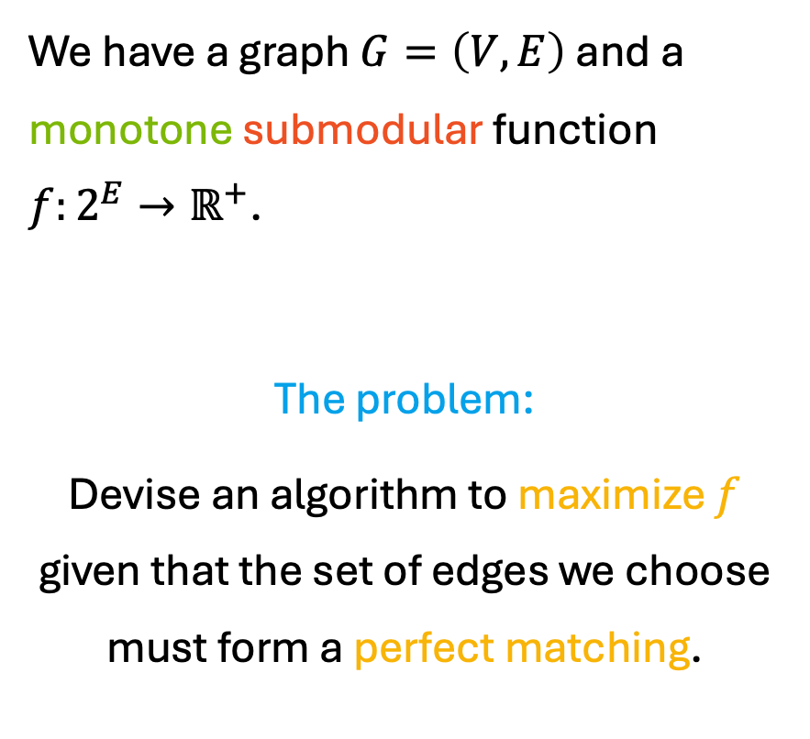
Interesting Subcase
We have a graph $G=\left(V, E\right)$ and a monotone submodular function $f:2^{E}→ℝ^{+}$.
The problem:
Devise an algorithm to maximize $f$ given that the set of edges we choose must form a perfect matching.
Current Best Approximation Ratios:
$\frac{1}{n}$ where $n$ is the number of vertices.
$\frac{1}{d}$ if $G$ is a $d$-regular bipartite graph.
$O\left(\frac{1}{√m}\right)$ where $m$ is the number of edges (Goemans, Harvey, Iwata, Mirrokni, ‘09).

Slide 6

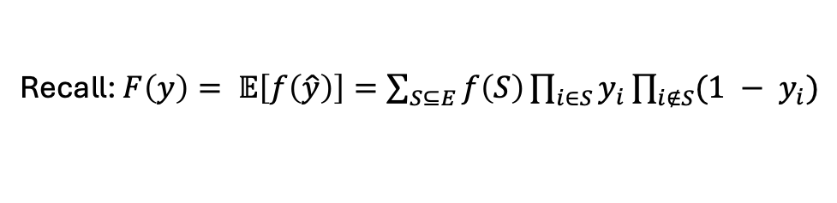

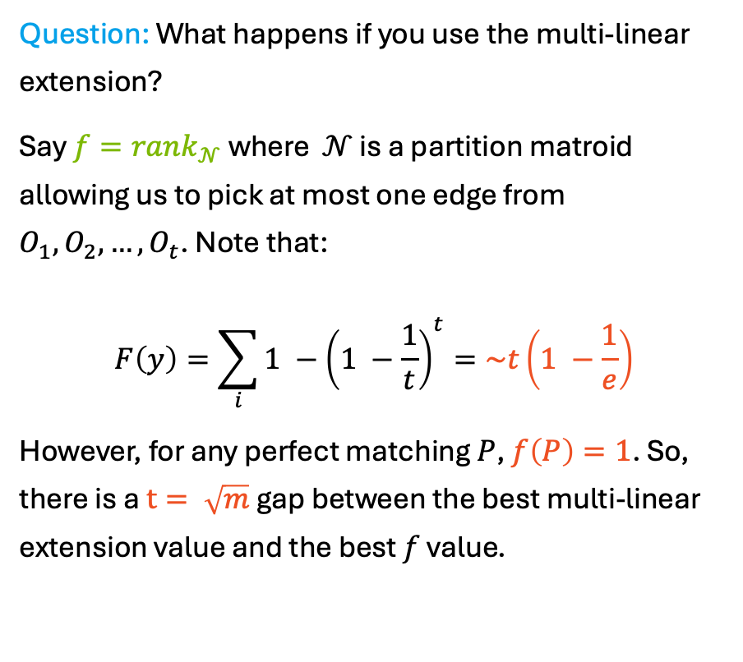

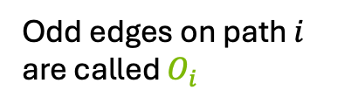

Interesting Subcase
Recall: $F\left(y\right)= 𝔼\left[f\left(\hat{y}\right)\right]=\sum_{S⊆E}{f\left(S\right)\prod_{i∈S}{y_{i}\prod_{i∉S}{{(1 − y}_{i})}}}$
Question: What happens if you use the multi-linear extension?
Say $f=rank_{𝒩}$ where $𝒩$ is a partition matroid allowing us to pick at most one edge from $O_{1},O_{2},…, O_{t}$. Note that:
$$F\left(y\right)=\sum_{i}{1 −{\left(1 −\frac{1}{t}\right)}^{t}}=\sim t\left(1 −\frac{1}{e}\right)$$
However, for any perfect matching $P$, $f\left(P\right)=1$. So, there is a $t= \sqrt{m}$ gap between the best multi-linear extension value and the best $f$ value.
Odd edges on path $i$ are called $O_{i}$
degree $t$
…
$y_{e}=\frac{1}{t}$ for $e∈O_{i}$
…
…
length $t−2$ path
$y_{e}=\frac{t−1}{t}$ for $e∉O_{i}$
…
(El Halabi, Tarnawski, Norouzi-Fard, Vuong, 2023)

Slide 7
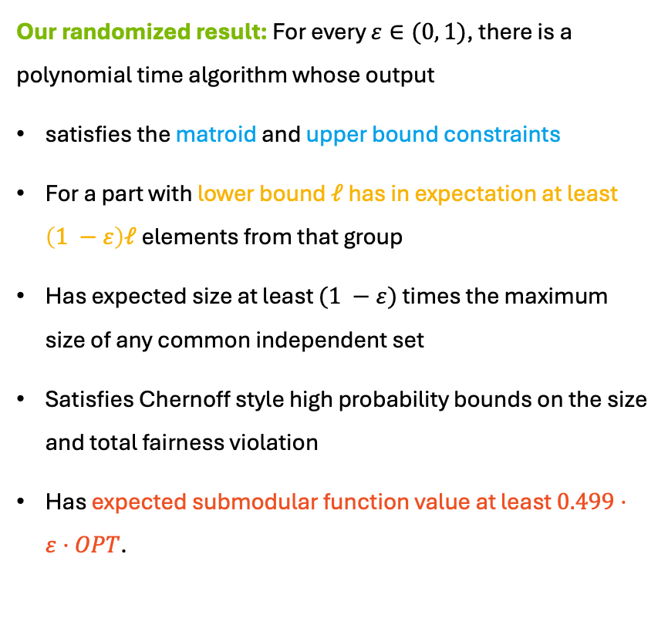
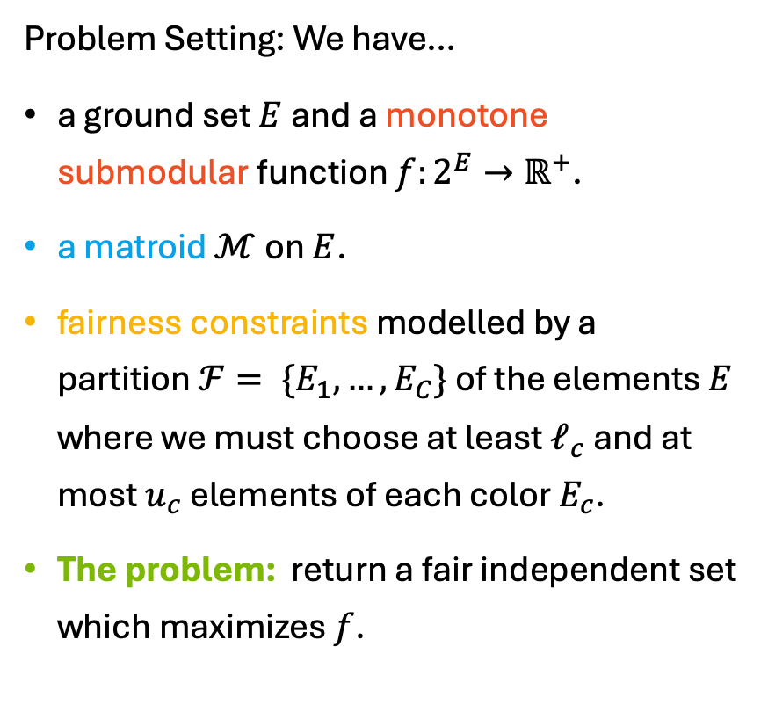
Our Results
Problem Setting: We have…
a ground set $E$ and a monotone submodular function $f:2^{E}→ℝ^{+}$.
a matroid $ℳ$ on $E$.
fairness constraints modelled by a partition$ℱ= \{E_{1},…, E_{C}\}$ of the elements $E$ where we must choose at least $ℓ_{c}$ and at most $u_{c}$ elements of each color $E_{c}$.
The problem: return a fair independent set which maximizes $f$.
Our randomized result: For every $ε∈(0, 1)$, there is a polynomial time algorithm whose output
satisfies the matroid and upper bound constraints
For a part with lower bound $ℓ$ has in expectation at least $\left(1 −ε\right)ℓ$ elements from that group
Has expected size at least $(1 −ε)$ times the maximum size of any common independent set
Satisfies Chernoff style high probability bounds on the size and total fairness violation
Has expected submodular function value at least $0.499⋅ε⋅OPT$.

Slide 8
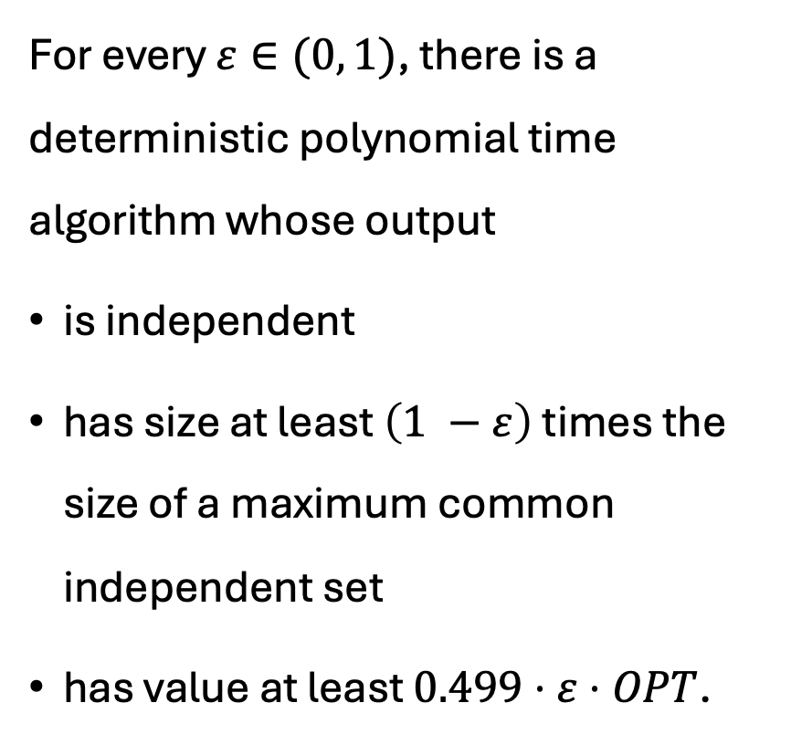
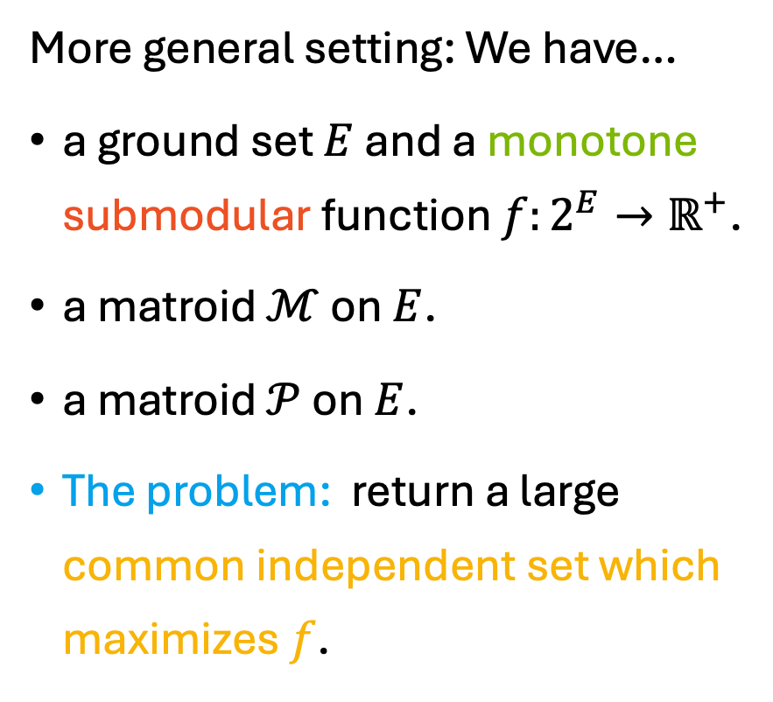
Our Results
More general setting: We have…
a ground set $E$ and a monotone submodular function $f:2^{E}→ℝ^{+}$.
a matroid $ℳ$ on $E$.
a matroid $𝒫$ on $E$.
The problem: return a large common independent set which maximizes $f$.
For every $ε∈(0, 1)$, there is a deterministic polynomial time algorithm whose output
is independent
has size at least $\left(1 −ε\right)$ times the size of a maximum common independent set
has value at least $0.499⋅ε⋅OPT$.
packing constraints
covering constraints

Slide 9
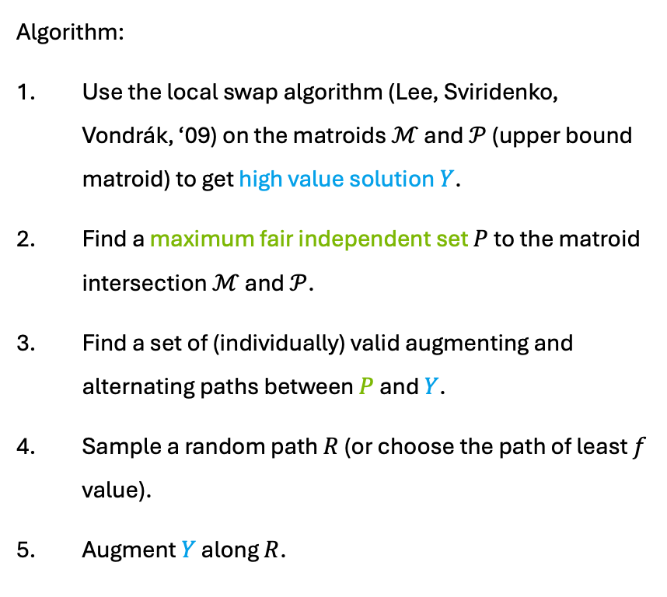


The Algorithm
Algorithm:
Use the local swap algorithm (Lee, Sviridenko, Vondrák, ‘09) on the matroids $ℳ$ and $𝒫$ (upper bound matroid) to get high value solution $Y$.
Find a maximum fair independent set $P$ to the matroid intersection $ℳ$ and $𝒫$.
Find a set of (individually) valid augmenting and alternating paths between $P$ and $Y$.
Sample a random path $R$ (or choose the path of least $f$ value).
Augment $Y$ along $R$.
Example in the bipartite matching case:
matroid$ℳ$
fairness upper bound matroid $𝒫$

Slide 10







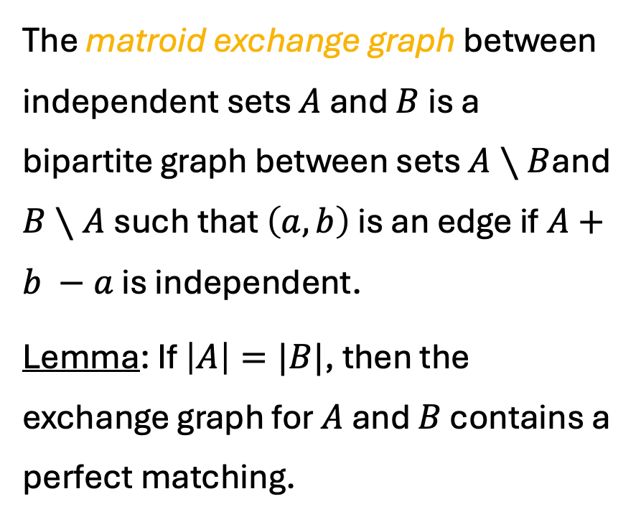










The Structure of Augmenting Paths
The matroid exchange graph between independent sets $A$ and $B$ is a bipartite graph between sets $A∖B$and $B∖A$such that $\left(a,b\right)$ is an edge if$A+b −a$ is independent.
Lemma: If $\left|A\right|=|B|$, then the exchange graph for $A$ and $B$ contains a perfect matching.
Example in the bipartite matching case:
$$p_{1}$$
$$p_{1}$$
$$p_{1}$$
$$y_{1}$$
$$y_{1}$$
$$y_{1}$$
$$p_{2}$$
$$p_{2}$$
$$p_{2}$$
$$y_{2}$$
$$y_{2}$$
$$y_{2}$$
$$p_{3}$$
$$p_{3}$$
$$p_{3}$$
exchange graph for $𝒫$
exchange graph for $ℳ$

Slide 11




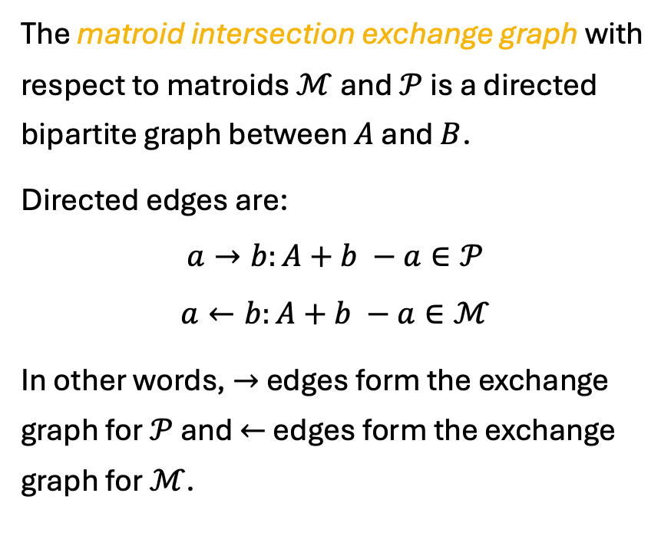






The Structure of Augmenting Paths
The matroid intersection exchange graph with respect to matroids $ℳ$ and $𝒫$ is a directed bipartite graph between $A$ and $B$.
Directed edges are:
$$a→b:A+b −a∈𝒫$$
$$a←b:A+b −a∈ℳ$$
In other words, $→$ edges form the exchange graph for $𝒫$ and $←$ edges form the exchange graph for $ℳ$.
Example in the bipartite matching case:
$$p_{1}$$
$$y_{1}$$
$$p_{1}$$
$$y_{1}$$
$$p_{2}$$
$$p_{2}$$
$$y_{2}$$
$$y_{2}$$
$$p_{3}$$
$$p_{3}$$

Slide 12


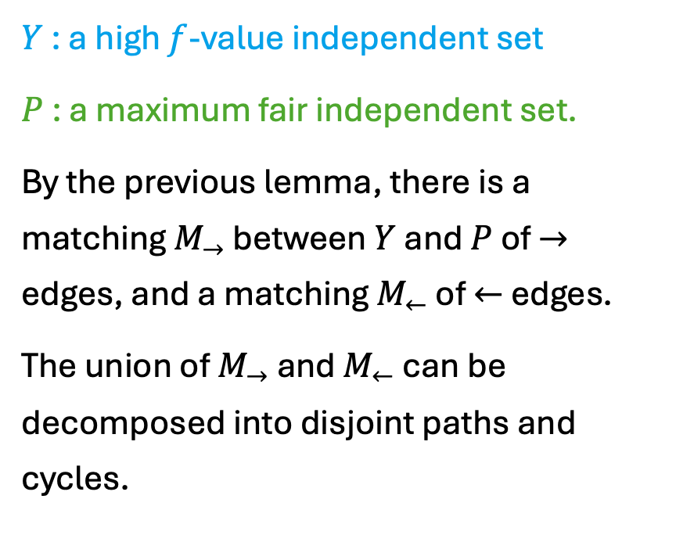







The Structure of Augmenting Paths
$Y$ : a high $f$-value independent set
$P$ : a maximum fair independent set.
By the previous lemma, there is a matching $M_{→}$ between $Y$ and $P$ of $→$ edges, and a matching $M_{←}$ of $←$ edges.
The union of $M_{→}$ and $M_{←}$ can be decomposed into disjoint paths and cycles.
$$p_{1}$$
$$p_{4}$$
$$y_{6}$$
$$y_{1}$$
$$p_{2}$$
$$y_{4}$$
$$p_{6}$$
$$y_{2}$$
$$p_{5}$$
$$y_{5}$$
$$p_{3}$$
Notes:
Assume they are disjoint?

Slide 13


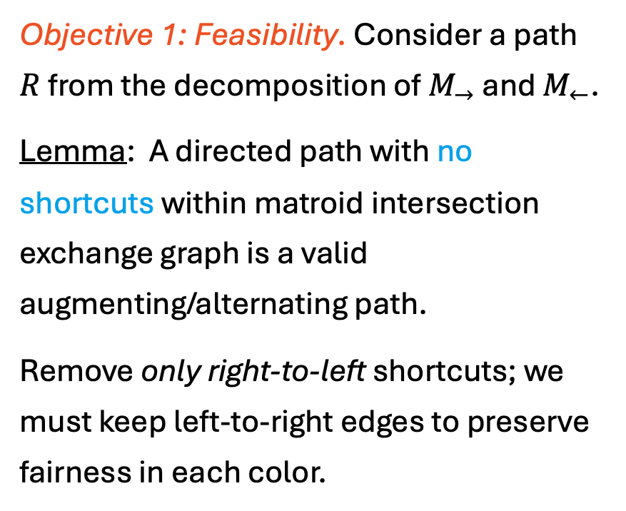





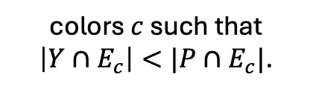

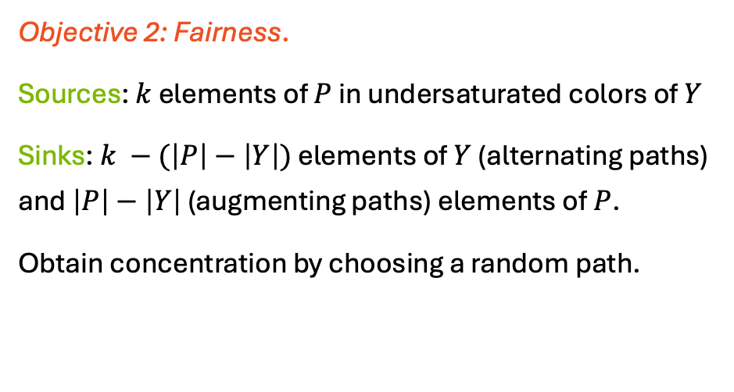


Feasibility and Fairness
colors $c$ such that $\left|Y∩E_{c}\right|<|P∩E_{c}|$.
Objective 1: Feasibility. Consider a path $R$ from the decomposition of $M_{→}$ and $M_{←}$.
Lemma: A directed path with no shortcuts within matroid intersection exchange graph is a valid augmenting/alternating path.
Remove only right-to-left shortcuts; we must keep left-to-right edges to preserve fairness in each color.
Objective 2: Fairness.
Sources: $k$ elements of $P$ in undersaturated colors of $Y$
Sinks: $k −(\left|P\right|−\left|Y\right|)$ elements of $Y$ (alternating paths) and $\left|P\right|−\left|Y\right|$ (augmenting paths) elements of $P$.
Obtain concentration by choosing a random path.
$$b$$
$$a$$
$$a$$
$$b$$
$$c$$
$$d$$
$$e$$
$$d$$
$$c$$
$$e$$
Notes:
Assume they are disjoint?

Slide 14
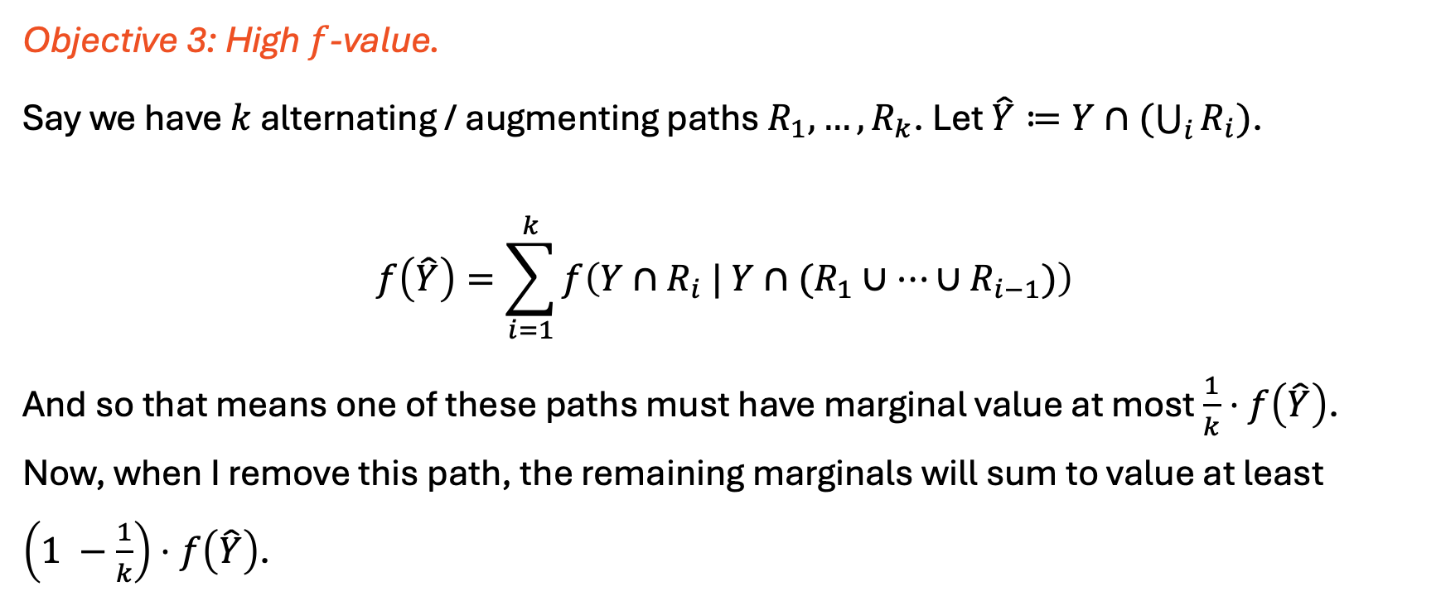
High Value
Objective 3: High $f$-value.
Say we have $k$ alternating / augmenting paths $R_{1},…, R_{k}$. Let $\hat{Y}≔Y∩(\bigcup_{i}{R_{i}})$.
$$f\left(\hat{Y}\right)=\sum_{i=1}^{k}{f\left(Y∩R_{i} | Y∩(R_{1}∪…∪R_{i−1})\right)}$$
And so that means one of these paths must have marginal value at most $\frac{1}{k}⋅f\left(\hat{Y}\right)$. Now, when I remove this path, the remaining marginals will sum to value at least $\left(1 −\frac{1}{k}\right)⋅f\left(\hat{Y}\right)$.

Slide 15
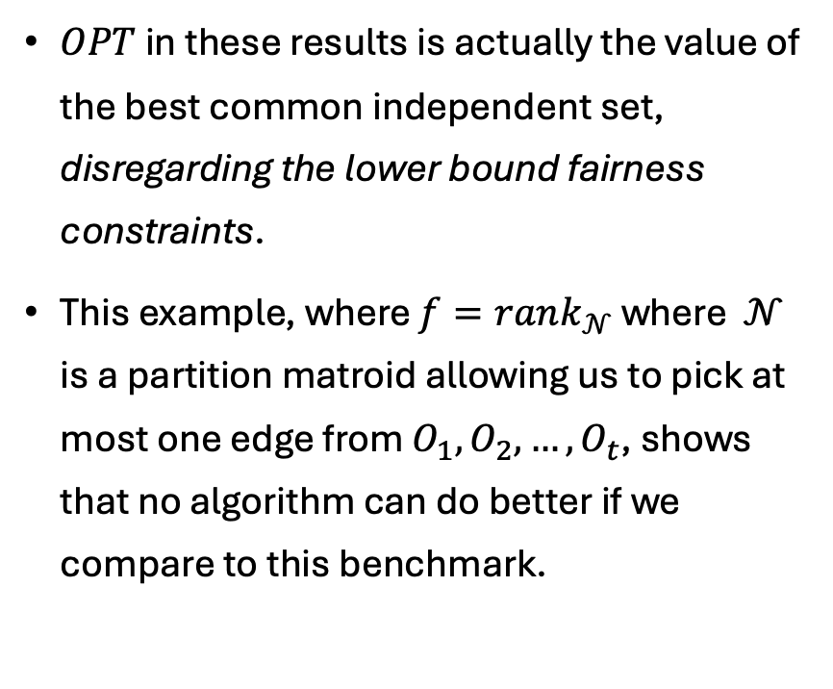
Optimality of this Approach
$OPT$ in these results is actually the value of the best common independent set, disregarding the lower bound fairness constraints.
This example, where $f=rank_{𝒩}$ where $𝒩$ is a partition matroid allowing us to pick at most one edge from $O_{1},O_{2},…, O_{t}$, shows that no algorithm can do better if we compare to this benchmark.
Odd edges on path $i$ are called $O_{i}$
degree $t$
…
…
…
length $t−2$ path
…

Slide 16
Next Steps
1. Is there a constant factor approximation for MSM with respect to perfect matchings in general? In certain regimes?
Dense graphs?
High degree graphs?
Constant number of fairness constraints?
Or is there a superconstant hardness of approximation?
Question (Vondrák): Can any problem which can be approximated with a linear objective also be approximated with a monotone submodular objective?
2. Non-monotone results? Other notions of fairness? Streaming?

