Slide 1

Beyond 1/2-Approximation for Submodular Maximization on Massive Data Streams
Ashkan Norouzi-Fard, Jakub Tarnawski, Slobodan Mitrović,
Amir Zandieh, Aida Mousavifar, Ola Svensson

Slide 2
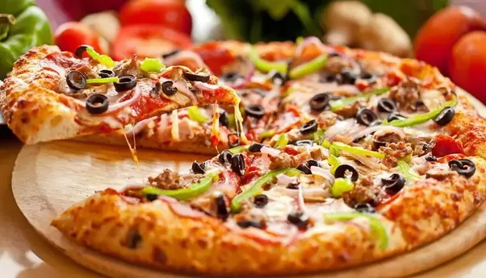

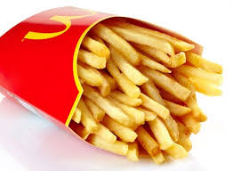
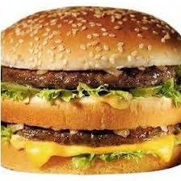


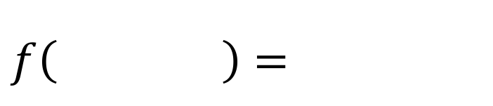



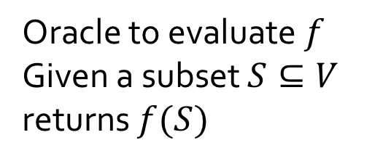
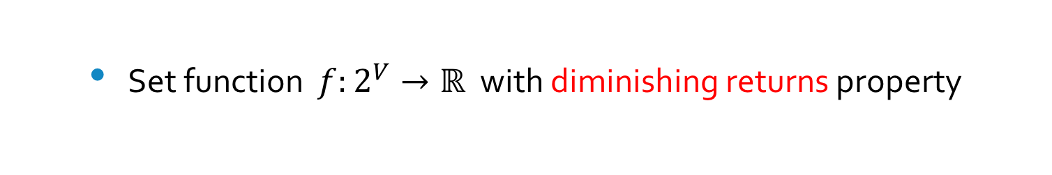



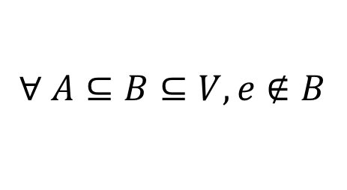

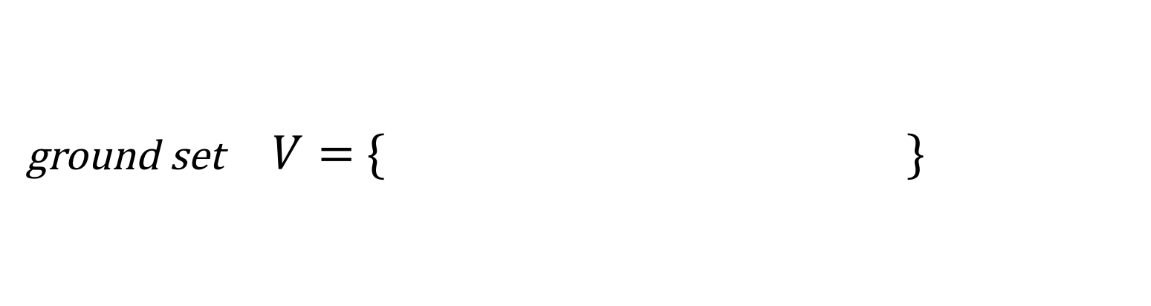
Submodularity
ground set $V=$ $\{ \}$
Set function $f:2^{V}→ℝ$ with diminishing returns property
$$S⊆V$$
$f\left( \right)=$
cost, utility, …
$$∀ A⊆B⊆V, e∉B$$
Oracle to evaluate $f$
Given a subset $S⊆V$
returns $f(S)$
$$A$$
$$B$$
$$f\left(A∪\left\{e\right\}\right)−f(A)$$
$$≥$$
$$f\left(B∪\left\{e\right\}\right)−f(B)$$
$$1$$

Slide 3

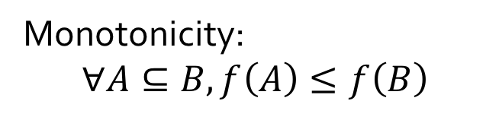

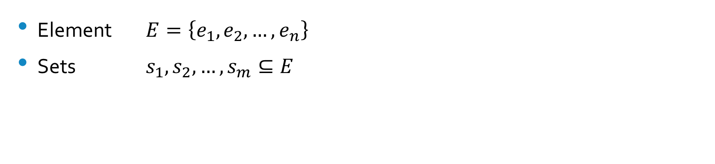



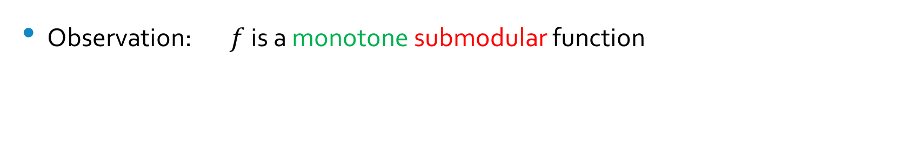




Example: the Coverage Problem
Element $E=\left\{e_{1},e_{2},…,e_{n}\right\}$
Sets $s_{1},s_{2}, …,s_{m}⊆E$
  $$∀ S=\left\{s_{i_{1}},s_{i_{2}},…,s_{i_{k}}\right\}$$
$f\left(S\right)=|∪_{s_{i}∈S}s_{i}|$
Observation: $f$ is a monotone submodular function
$S_{4}$
$S_{6}$
$S_{1}$
$S_{2}$
Monotonicity:
$$∀A⊆B, f\left(A\right)≤f\left(B\right)$$
$S_{5}$
$S_{3}$
$$2$$

Slide 4
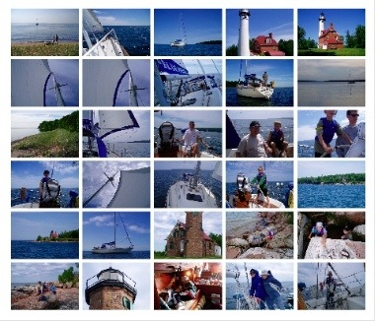




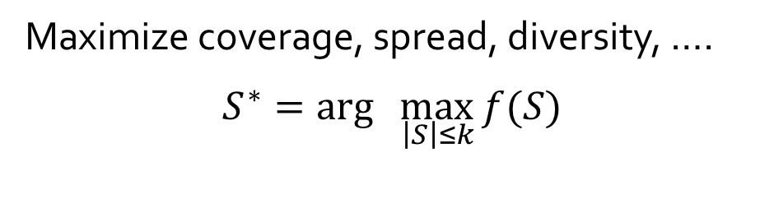

Maximize coverage, spread, diversity, ….
$$S^{∗}=arg\max_{ \left|S\right|≤k}{f(S)}$$
$$3$$

Slide 5


Problem
Extract a small, representative subset out of big data set
$$S^{∗}=arg\max_{ \left|S\right|≤k}{f(S)}$$
We assume $f$ is submodular, monotone, and $f\left(∅\right)=0$
$$4$$

Slide 6


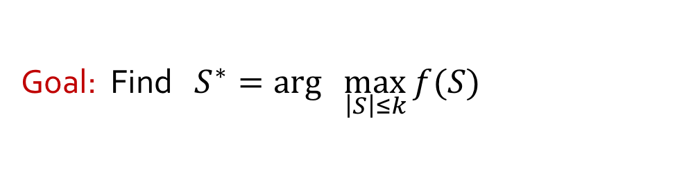



The Greedy Algorithm
[NWF $‘78$]
Goal: Find $S^{∗}=arg\max_{ \left|S\right|≤k}{f(S)}$
Greedy is impractical
  Impractical in large scale applications
  Require repeated access to the complete dataset
$$=Δf$$
$$f\left( \right)$$
$$≥\left(1−1/e\right)OPT$$
Is there an algorithm to summarize data on the fly?
$$5$$

Slide 7

Streaming Model
Input arrives one element at a time, rather than being available all at once
Only a small portion of the data can be kept in memory at any point
$$6$$

Slide 8
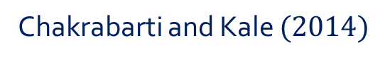
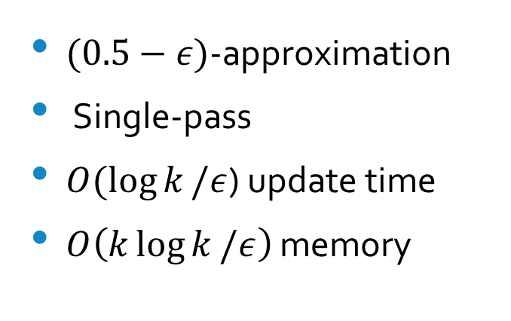


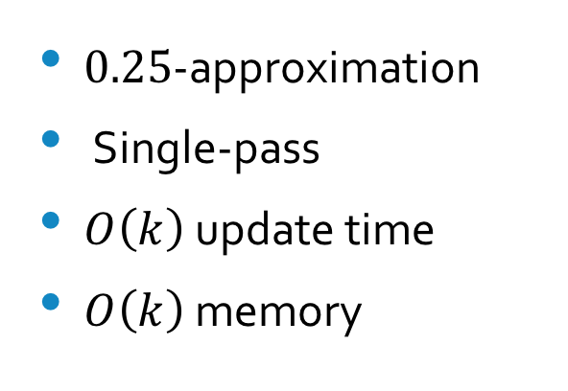
Related Work
Chakrabarti and Kale $(2014)$
Badanidiyuru et al $(2014)$
SIEVE -STREAMING
$0.25$-approximation
Single-pass
$O\left(k\right)$ update time
$O\left(k\right)$ memory
$(0.5−ε)$-approximation
Single-pass
$O(\log{k}/ε$) update time
$O\left(k\log{k}/ε\right)$ memory
$$7$$

Slide 9



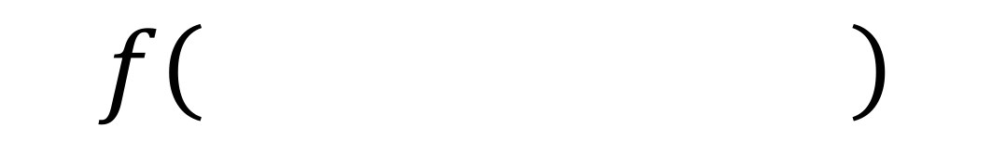



SIEVE –STREAMING
[BMKK $′14$]
Data Stream
$$≥^{?}\frac{OPT/2−f(S)}{k−|S|}$$
$$Δf=$$
$1$-pass
$O(k)$ memory
$$f\left( \right)$$
$$≥0.5 OPT$$
$$8$$

Slide 10


Can we do better than $1/2$?
$$9$$

Slide 11


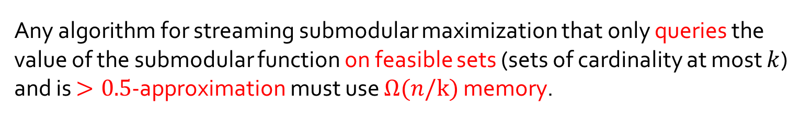
Theorem
Any algorithm for streaming submodular maximization that only queries the value of the submodular function on feasible sets (sets of cardinality at most $k$) and is $>0.5$-approximation must use $Ω(n/k)$ memory.
This hardness includes randomized algorithms, and applies even for estimating the optimum value
Proof via communication complexity
This bound pertains to arbitrary-order streams
$$10$$

Slide 12


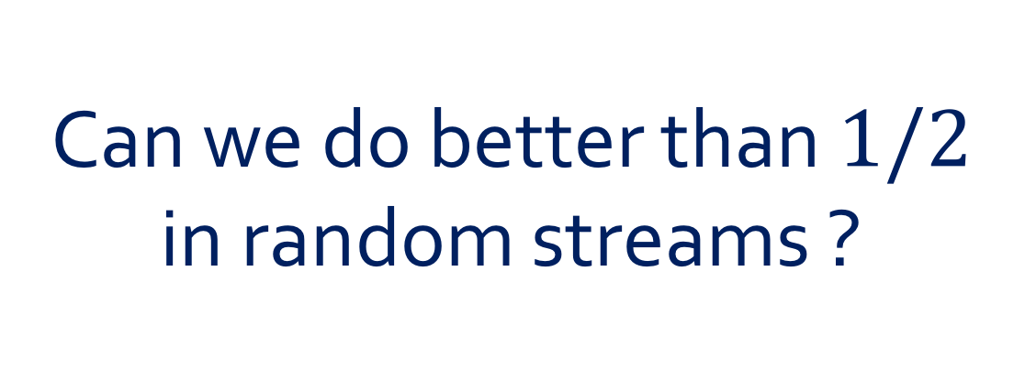
Can we do better than $1/2$ in random streams ?
$$11$$

Slide 13


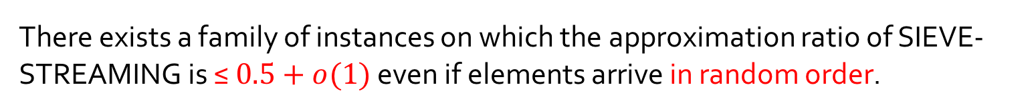
Does SIEVE -STREAMING beat $1/2$
in random streams ?
Theorem
There exists a family of instances on which the approximation ratio of SIEVE-STREAMING is ≤ $0.5+o(1)$ even if elements arrive in random order.
$$12$$

Slide 14

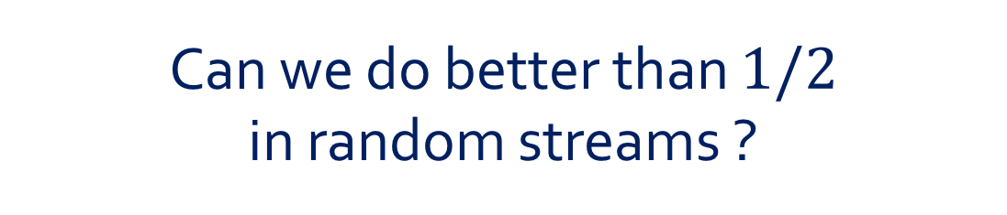

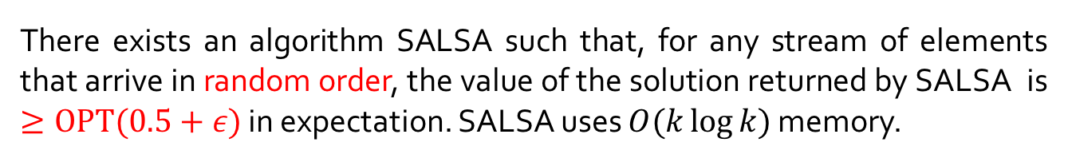
Can we do better than $1/2$ in random streams ?
Theorem
There exists an algorithm SALSA such that, for any stream of elements that arrive in random order, the value of the solution returned by SALSA is $≥OPT(0.5+ε)$ in expectation. SALSA uses $O(k\log{k})$ memory.
$$13$$

Slide 15

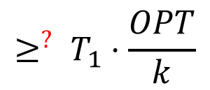





Main Idea
Adaptive thresholds
$$β\%$$
$$(1−β)\%$$
$$≥^{?} T_{1}⋅\frac{OPT}{k}$$
$$≥^{?} T_{2}⋅\frac{OPT}{k}$$
Structure of OPT
Dense
Balanced
$$D$$
$\left|D\right|≤\frac{k}{100}$ and $f\left(D\right)≥\frac{OPT}{10}$
$$14$$

Slide 16


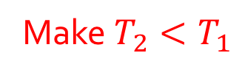
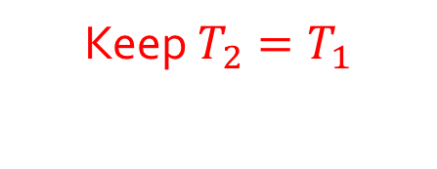

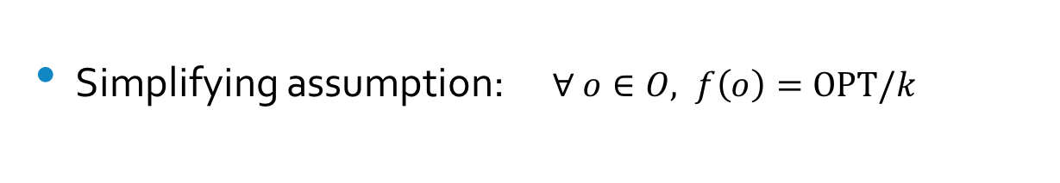




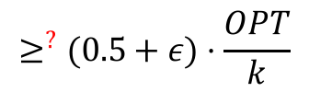



Balanced Case
Simplifying assumption: $∀ o∈O, f\left(o\right)=OPT/k$
$$10\%$$
$$90\%$$
$$o_{1}$$
$$o_{2}$$
$$o_{3}$$
$$o_{4}$$
$$≥^{?}(0.5+ε)⋅\frac{OPT}{k}$$
$$≥^{?} T_{2}⋅\frac{OPT}{k}$$
$f(S)$ is large
$S$ contains elements of OPT
Make $T_{2}<T_{1}$
Keep $T_{2}=T_{1}$
$$15$$

Slide 17
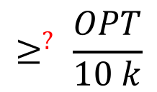





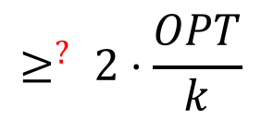
Dense Case
$$D$$
$\left|D\right|≤\frac{k}{100}$ and $f\left(D\right)≥\frac{OPT}{10}$
$$80\%$$
$$20\%$$
$$≥^{?} 2⋅\frac{OPT}{k}$$
$$≥^{?} \frac{OPT}{10 k}$$
$$16$$

Slide 18
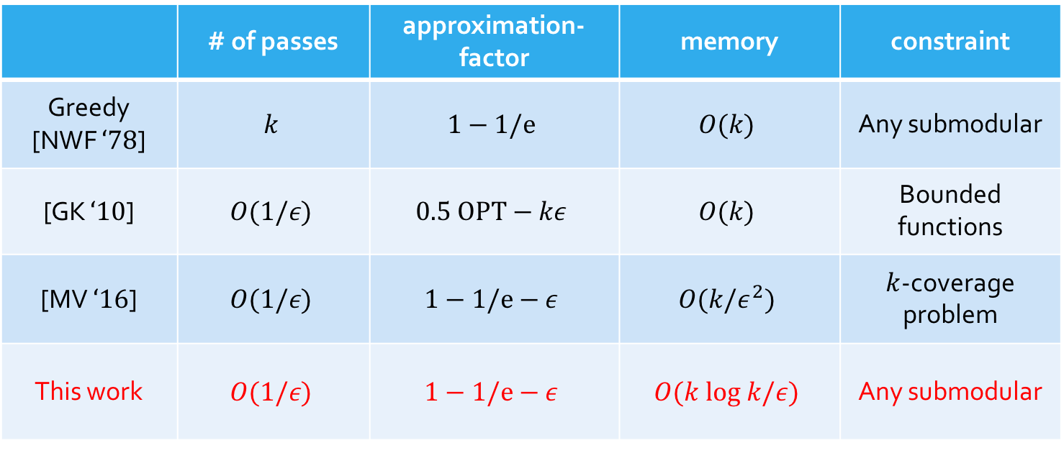

Multiple-Pass
 | # of passes | approximation-factor | memory | constraint
Greedy [NWF $‘78$] | $$k$$ | $$1−1/e$$ | $$O(k)$$ | Any submodular
[GK $‘10$] | $$O(1/ε)$$ | $$0.5 OPT−kε$$ | $$O(k)$$ | Bounded functions
[MV $‘16$] | $$O(1/ε)$$ | $$1−1/e−ε$$ | $$O(k/ε^{2})$$ | $k$-coverage problem
This work | $$O(1/ε)$$ | $$1−1/e−ε$$ | $$O(k log k/ε)$$ | Any submodular
$$17$$

Slide 19
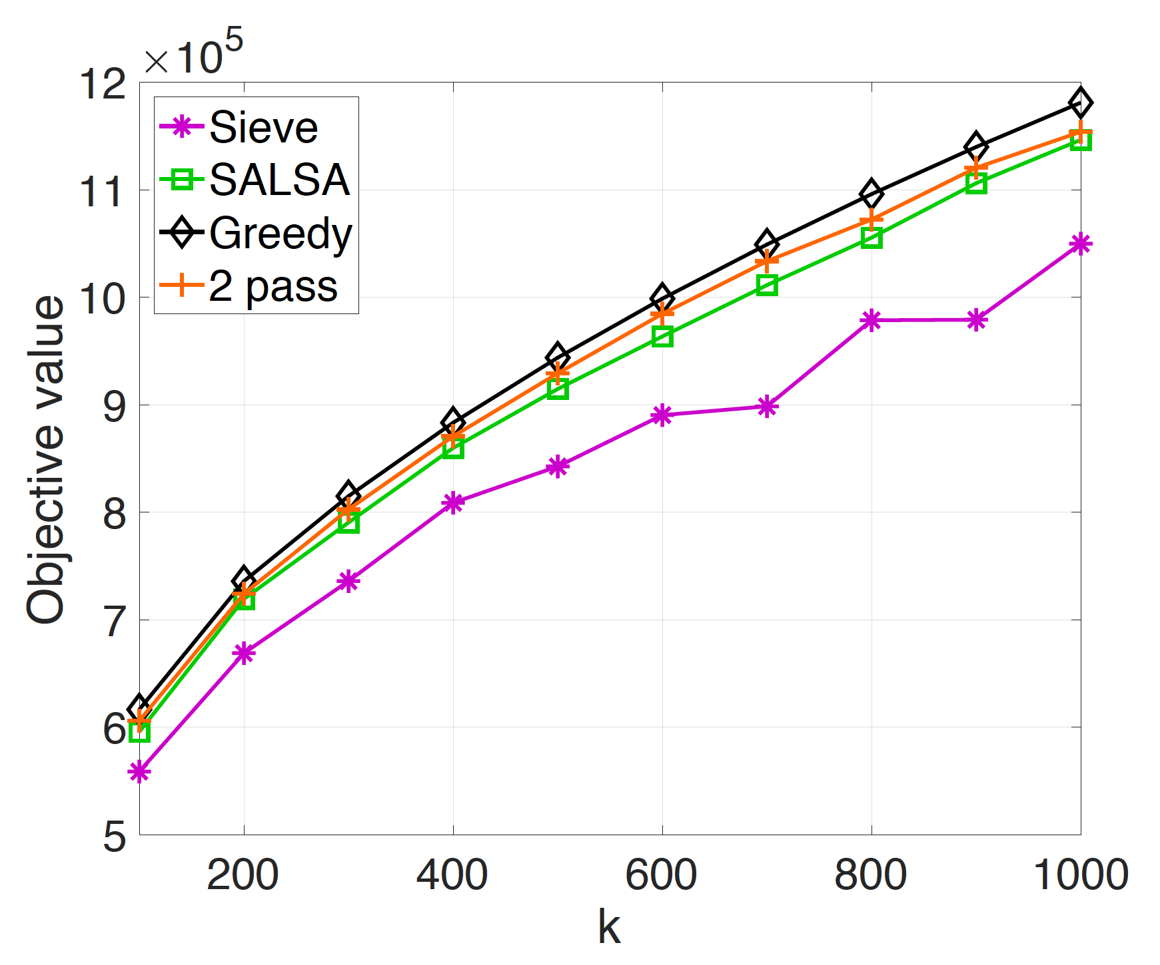
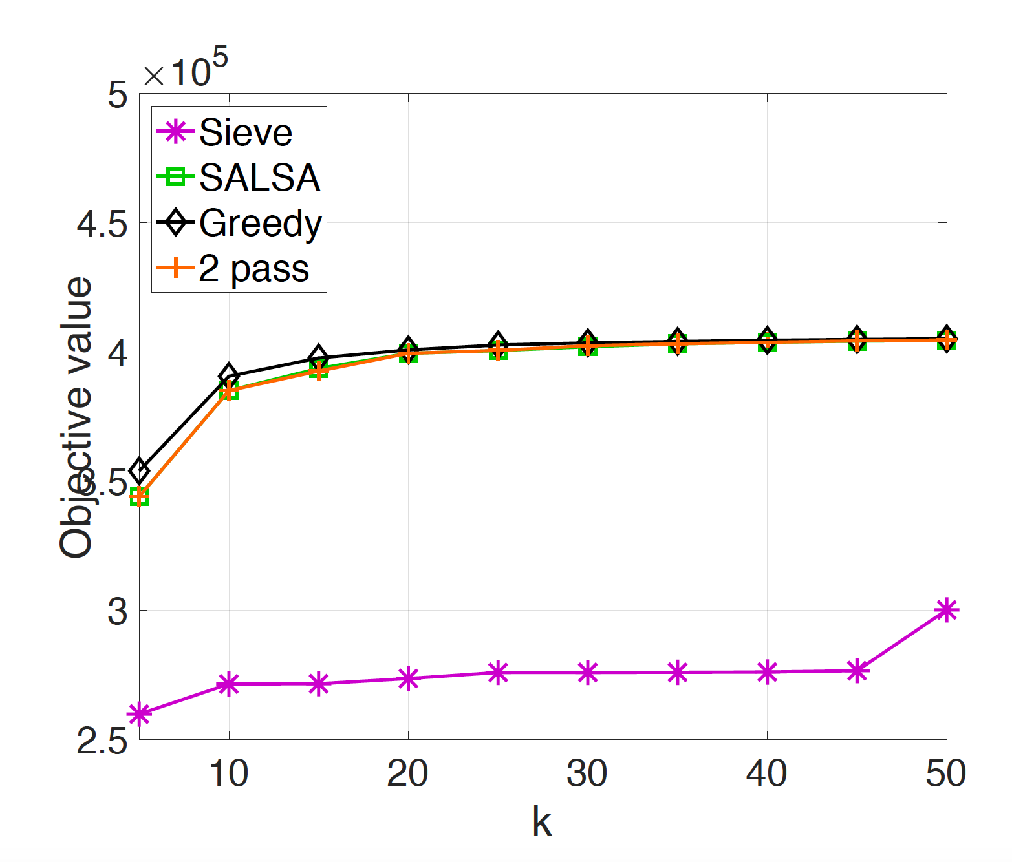

Experiments
Maximum Coverage
Exemplar-based Clustering
Data Set: Orkut social network
Data Set: Spambase
$$18$$

Slide 20
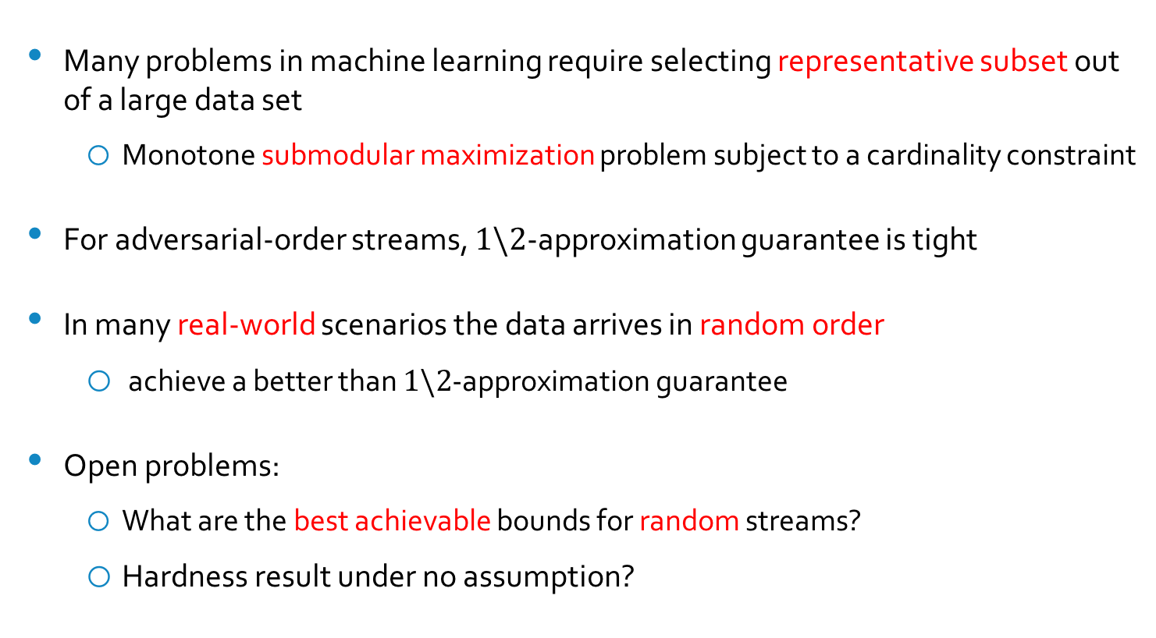

Conclusion
Many problems in machine learning require selecting representative subset out of a large data set
  Monotone submodular maximization problem subject to a cardinality constraint
For adversarial-order streams, $1\backslash 2$-approximation guarantee is tight
In many real-world scenarios the data arrives in random order
  achieve a better than $1\backslash 2$-approximation guarantee
Open problems:
  What are the best achievable bounds for random streams?
  Hardness result under no assumption?
$$19$$

Slide 21

Thank You

Slide 22
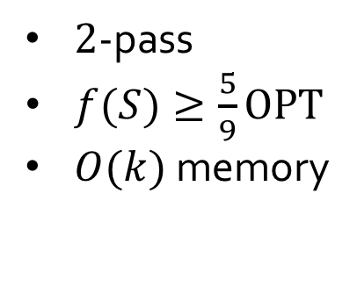
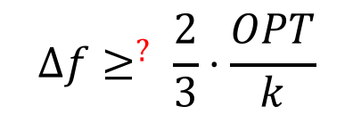
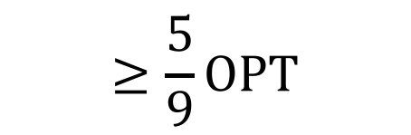

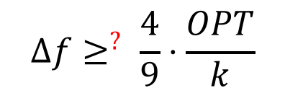
Two-Pass
Data Stream
Pass 1
Pass 2
$${Δf≥}^{?} \frac{2}{3}⋅\frac{OPT}{k}$$
$${Δf≥}^{?} \frac{4}{9}⋅\frac{OPT}{k}$$
$2$-pass
$f(S)≥\frac{5}{9}OPT$
$O(k)$ memory
$$f\left( \right)$$
$$≥\frac{5}{9}OPT$$
$$18$$

Slide 23

$P$-Pass
Pass $i$: ${Δf≥}^{?} {\left(\frac{p}{p+1}\right)}^{i}⋅\frac{OPT}{k }$
$f\left(S\right)≥OPT\left(1−{\left(\frac{p}{p+1}\right)}^{p}\right)$
    $f\left(S\right)≥OPT(1−\frac{1}{e}−ε)$ when $p=O\left(\frac{1}{ε}\right)$
$O(k)$ memory
$$19$$

