Slide 1
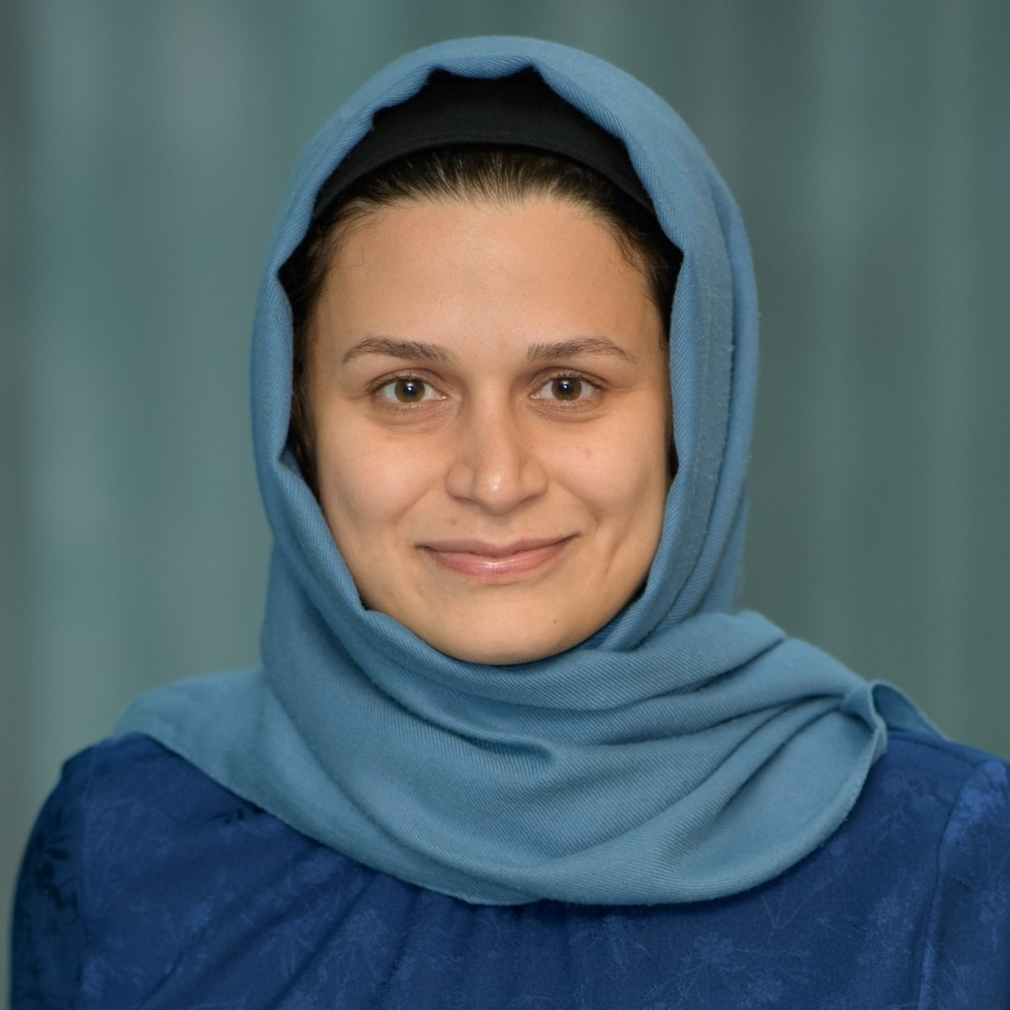
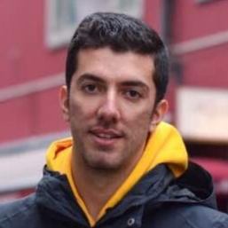
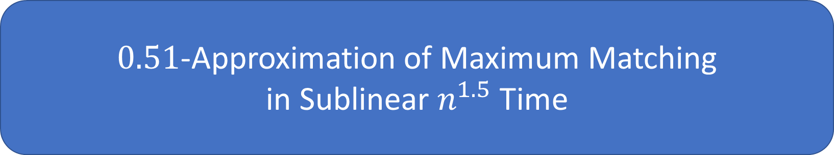
$0.51$-Approximation of Maximum Matching in Sublinear $n^{1.5}$ Time
Sepideh Mahabadi MSR
Mohammad Roghani Stanford, MSR intern
Jakub Tarnawski MSR
10.07.2025 ICALP

Slide 2

Sublinear matching
Goal: estimate size of maximum matching
Runtime: $n^{2−Ω(1)}$ ($n=|V|$)
Maximize approximation ratio

Slide 3

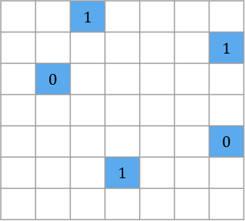












Access Model
$$1$$
$$1$$
$$2$$
$$2$$
$$3$$
$$3$$
$$4$$
$$⋮$$
$$⋮$$
$$n$$
$$n$$
Adjacency list
Adjacency matrix

Slide 4


Hard to find edges of any large matching
For any $O(1)$-apx, to find edges one needs $Ω(n^{2})$ time (same as reading entire input) [Parnas, Ron 07]
We estimate size of maximum matching
$$εn$$
$$εn$$

Slide 5
Bonus applications
Sublinear algorithms for matching can be used for:
Dynamic algorithms for matching size estimation [Behnezhad / Bhattacharya, Kiss, Saranurak, Wajc SODA 23 Best Paper]
Dynamic algorithms for maintaining a matching: checking for existence of large matching in a subgraph before spending time on constructing the entire matching [Behnezhad, Ghafari FOCS 24], [Assadi, Khanna, Kiss SODA 25]
Solving other problems such as Earth Mover’s distance, min-cost perfect matching, TSP, Steiner Tree [Beretta, Rubinstein STOC 24] [Behnezhad, Roghani, Rubinstein, Saberi ICALP 24] [Mahabadi, Roghani, Tarnawski, Vakilian ITCS 25]

Slide 6
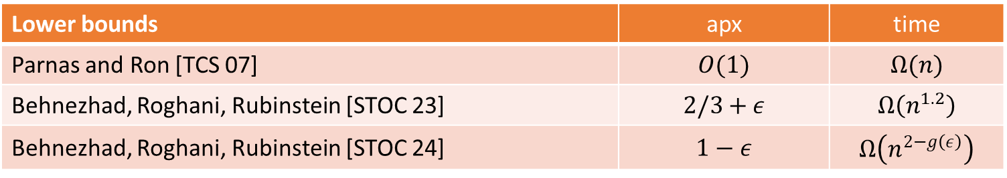
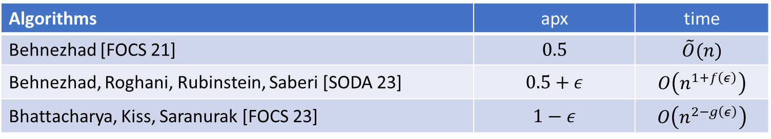
Prior works
Algorithms | apx | time
Behnezhad [FOCS 21] | $$0.5$$ | $$\tilde{O}(n)$$
Behnezhad, Roghani, Rubinstein, Saberi [SODA 23] | $$0.5+ε$$ | $$O\left(n^{1+f\left(ε\right)}\right)$$
Bhattacharya, Kiss, Saranurak [FOCS 23] | $$1−ε$$ | $$O\left(n^{2−g\left(ε\right)}\right)$$
Lower bounds | apx | time
Parnas and Ron [TCS 07] | $$O(1)$$ | $$Ω(n)$$
Behnezhad, Roghani, Rubinstein [STOC 23] | $$2/3+ε$$ | $$Ω\left(n^{1.2}\right)$$
Behnezhad, Roghani, Rubinstein [STOC 24] | $$1−ε$$ | $$Ω\left(n^{2−g\left(ε\right)}\right)$$

Slide 7



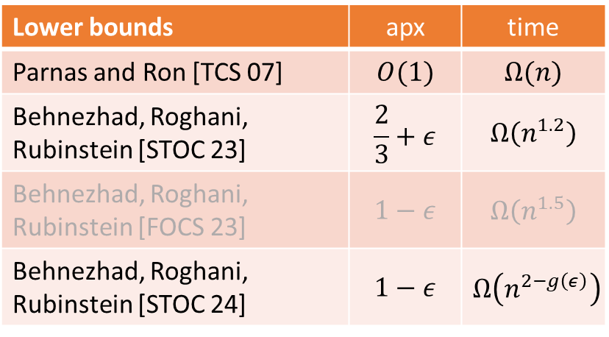


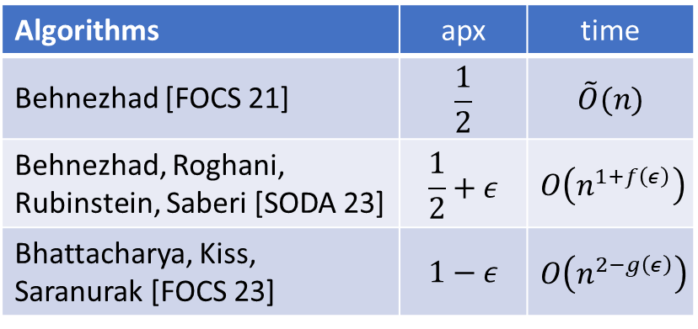




Prior works
Algorithms | apx | time
Behnezhad [FOCS 21] | $$\frac{1}{2}$$ | $$\tilde{O}(n)$$
Behnezhad, Roghani, Rubinstein, Saberi [SODA 23] | $$\frac{1}{2}+ε$$ | $$O\left(n^{1+f\left(ε\right)}\right)$$
Bhattacharya, Kiss, Saranurak [FOCS 23] | $$1−ε$$ | $$O\left(n^{2−g\left(ε\right)}\right)$$
time
[BKS FOCS’23]
$$n^{2−ε^{′′}}$$
[BRR STOC 24]
$$n^{1.5}$$
[BRR FOCS 23]
$$n^{1.2}$$
(only listing Pareto-optimal)
Lower bounds | apx | time
Parnas and Ron [TCS 07] | $$O(1)$$ | $$Ω(n)$$
Behnezhad, Roghani, Rubinstein [STOC 23] | $$\frac{2}{3}+ε$$ | $$Ω\left(n^{1.2}\right)$$
Behnezhad, Roghani, Rubinstein [FOCS 23] | $$1−ε$$ | $$Ω\left(n^{1.5}\right)$$
Behnezhad, Roghani, Rubinstein [STOC 24] | $$1−ε$$ | $$Ω\left(n^{2−g\left(ε\right)}\right)$$
[BRRS SODA 23]
[BRR STOC 23]
$$n^{1+ε^{′}}$$
[B FOCS 21]
$$n$$
[PR TCS 07]
$$\frac{1}{2}$$
$$\frac{1}{2}+ε$$
$$\frac{2}{3}$$
$$1−ε$$
apx
good

Slide 8


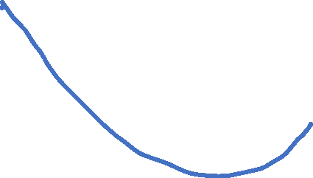
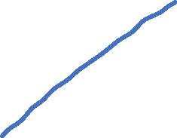
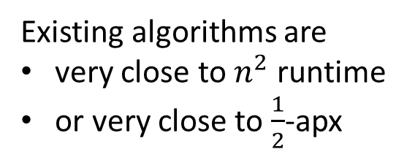

Prior works
time
[BKS FOCS’23]
$$n^{2−ε^{′′}}$$
[BRR STOC 24]
$$n^{1.5}$$
[BRR FOCS 23]
$$n^{1.2}$$
[BRRS SODA 23]
[BRR STOC 23]
$$n^{1+ε^{′}}$$
[B FOCS 21]
$$n$$
[PR TCS 07]
$$\frac{1}{2}$$
$$\frac{1}{2}+ε$$
$$\frac{2}{3}$$
$$1−ε$$
apx
Existing algorithms are
very close to $n^{2}$ runtime
or very close to $\frac{1}{2}$-apx
good
$$ε≈2^{−280}$$

Slide 9
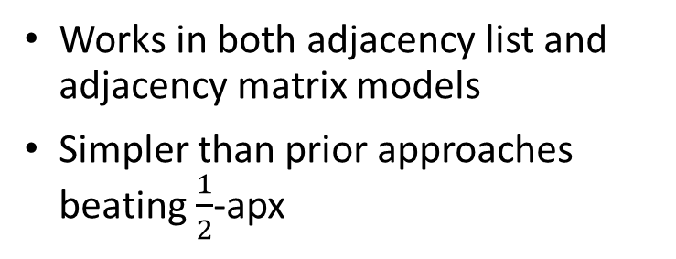
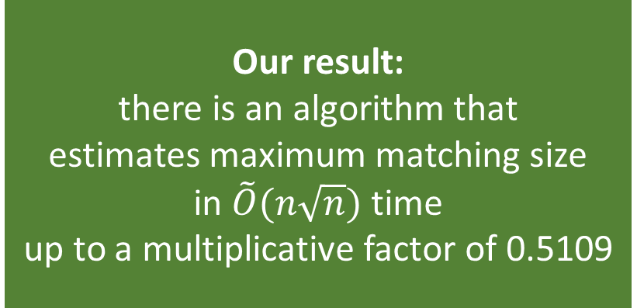


Our result
time
Our result: there is an algorithm that estimates maximum matching size in $\tilde{O}(n\sqrt{n})$ time up to a multiplicative factor of 0.5109
[BKS FOCS’23]
$$n^{2−ε^{′′}}$$
[BRR STOC 24]
$$n^{1.5}$$
[BRR FOCS 23]
$$n^{1.2}$$
[BRRS SODA 23]
[BRR STOC 23]
$$n^{1+ε^{′}}$$
[B FOCS 21]
$$n$$
[PR TCS 07]
Works in both adjacency list and adjacency matrix models
Simpler than prior approaches beating $\frac{1}{2}$-apx
$$\frac{1}{2}$$
$$\frac{1}{2}+ε$$
$$0.51$$
$$\frac{2}{3}$$
$$1−ε$$
apx
good

Slide 10
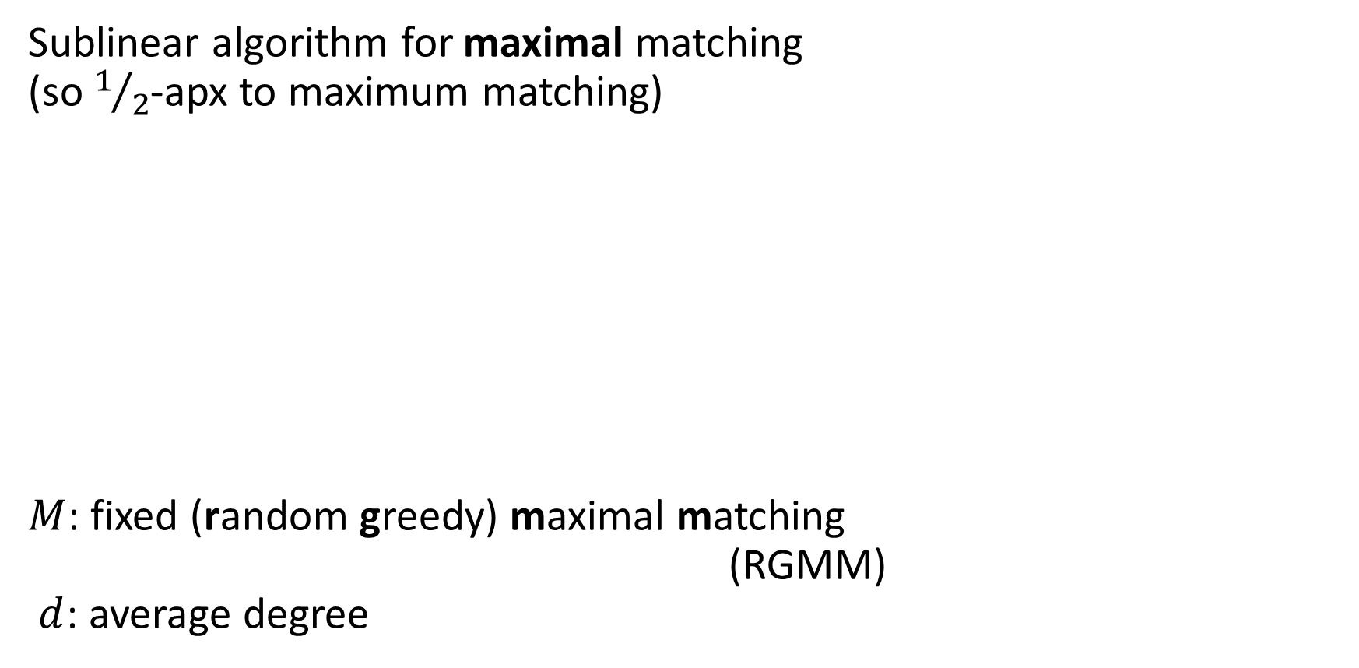



RGMM oracle [Behnezhad 21]
Sublinear algorithm for maximal matching (so $1/2$-apx to maximum matching)
$M$: fixed (random greedy) maximal matching (RGMM) $d$: average degree
$$v$$
Local RGMM oracle: for vertex $v$, says whether $v∈M$ in time $O(d)$
Algorithmic template:
given such an oracle $M(v)$,
ask about $r=\tilde{O}(1)$ vertices and return $$\frac{|\left\{i=1,…,r :M\left(v_{i}\right)=yes\right\}|}{r}⋅\frac{|V|}{2}$$
Notes:
This is very fast, but only finds a MAXIMAL matching, so it’s limited by 1/2 approximation

Slide 11

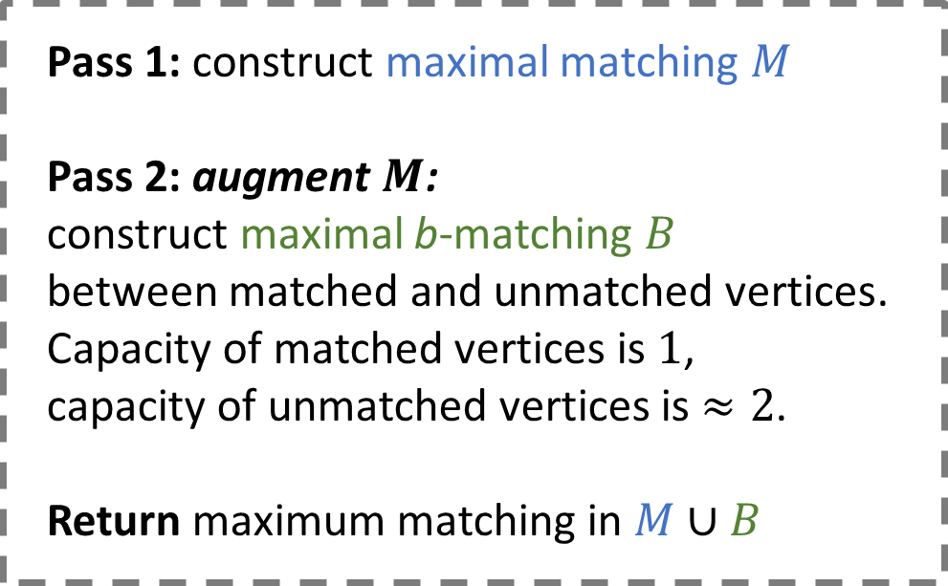
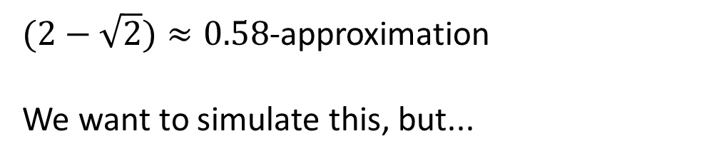



Two-pass semi-streaming algorithm
[Konrad, Naidu 21]
Pass 1: construct maximal matching $M$
Pass 2: augment $M$: construct maximal b-matching $B$ between matched and unmatched vertices. Capacity of matched vertices is $1$, capacity of unmatched vertices is $≈2$.
Return maximum matching in $M∪B$
$$OPT$$
$$M$$
$$B$$
$(2−\sqrt{2})≈0.58$-approximation
We want to simulate this, but...
Challenge 1: we cannot materialize a maximal matching $M$ in sublinear time

Slide 12

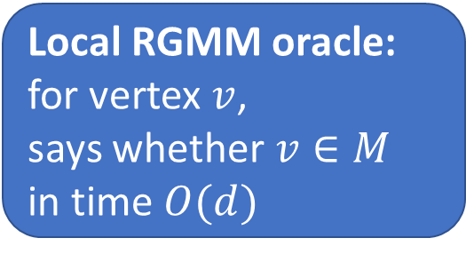
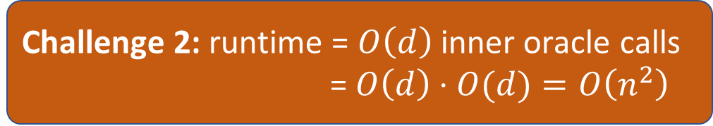



set up inner RGMM oracle to access
Local RGMM oracle: for vertex $v$, says whether $v∈M$ in time $O(d)$
$d$: avg degree
Pass 1: construct maximal matching $M$
Pass 2: augment $M$: construct maximal b-matching $B$ between matched and unmatched vertices. Capacity of matched vertices is $1$, capacity of unmatched vertices is $≈2$.
Return maximum matching in $M∪B$
$$OPT$$
$$M$$
$$B$$
set up outer RGMM oracle to access
Challenge 2: runtime = $O\left(d\right)$ inner oracle calls = $O\left(d\right)⋅O(d)=O\left(n^{2}\right)$
Can we reduce the degrees?
Notes:
Then, we again use [Behnezhad 21] oracle for the b-matching. When seeing edge $e$, to check whether $e$ is between matched and unmatched vertex, it invokes the inner oracle.

Slide 13
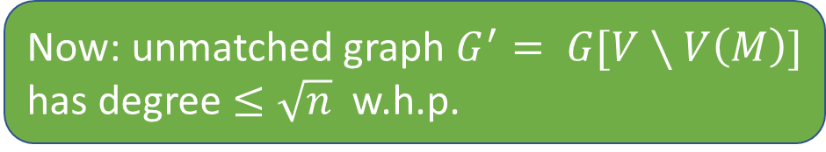




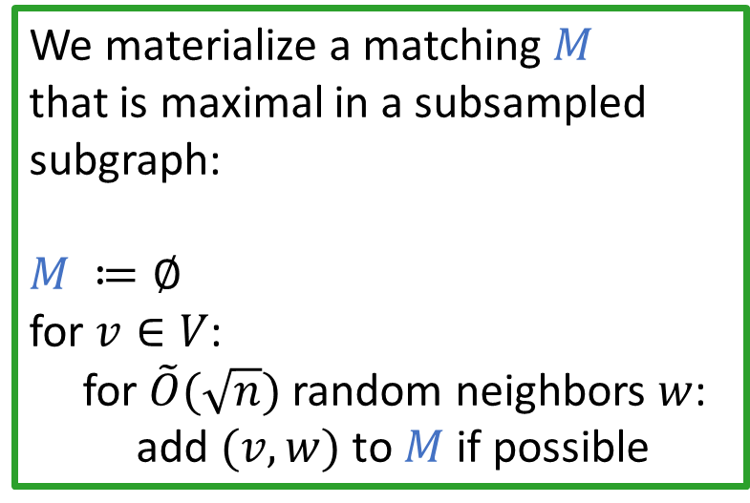
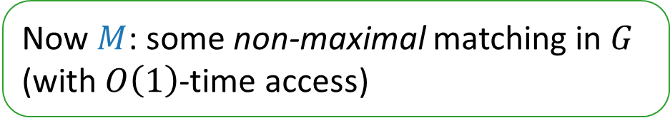
Start with sparsification
$$G′$$
We materialize a matching $M$ that is maximal in a subsampled subgraph:
$M ≔∅$
for $v∈V$:
for $\tilde{O}(\sqrt{n})$ random neighbors $w$: add $(v,w)$ to $M$ if possible
takes time $\tilde{O}\left(n\sqrt{n}\right)$
$$M$$
$$≤\sqrt{n}$$
Now $M$: some non-maximal matching in $G$ (with $O\left(1\right)$-time access)
Now: unmatched graph $G^{′}= G[V∖V\left(M\right)]$ has degree $≤\sqrt{n}$ w.h.p.

Slide 14













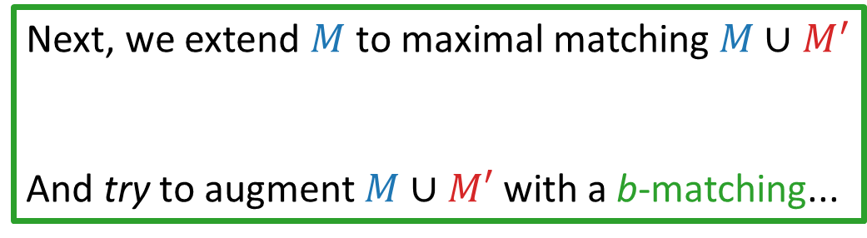


Start with sparsification
$$G′$$
We materialize a matching $M$ that is maximal in a subsampled subgraph:
$M ≔∅$
for $v∈V$:
for $\tilde{O}(\sqrt{n})$ random neighbors $w$: add $(v,w)$ to $M$ if possible
takes time $\tilde{O}\left(n\sqrt{n}\right)$
$$M$$
$$M′$$
Still $Ω\left(n^{2}\right)$ runtime though!
Why?
inner oracle works in $O\left(n\right)$ time, not $O(\sqrt{n})$, because it doesn’t have access to adjacency list of $G′$
Avg degree between $M$ and $G′$ is $Ω\left(n\right)$
Now $M$: some non-maximal matching in $G$ (with $O\left(1\right)$-time access)
Next, we extend $M$ to maximal matching $M∪M^{′}$
And try to augment $M∪M′$ with a b-matching...
set up inner RGMM oracle to access
Now: unmatched graph $G^{′}= G[V∖V\left(M\right)]$ has degree $≤\sqrt{n}$ w.h.p.
set up outer RGMM oracle to access

Slide 15
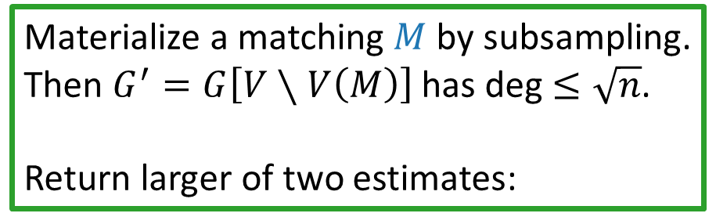
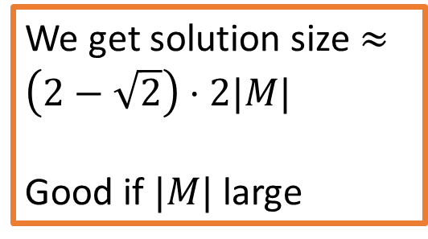

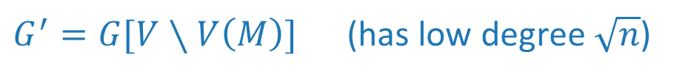
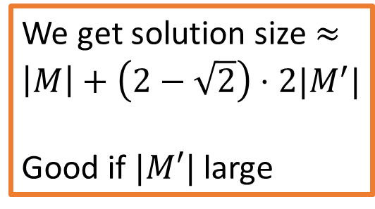


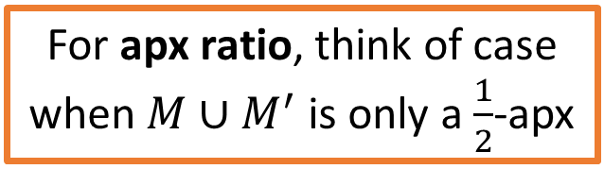

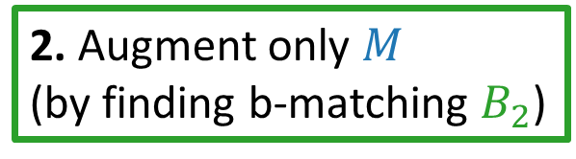

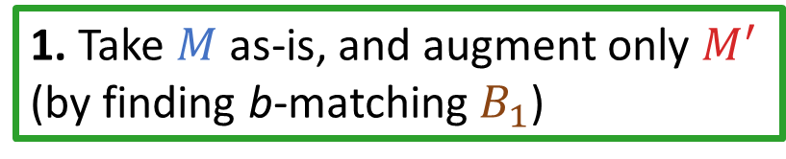
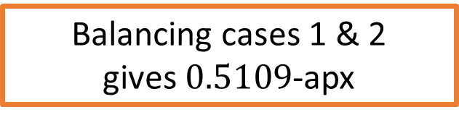

Final algorithm
$G^{′}=G[V∖V\left(M\right)]$ (has low degree $\sqrt{n}$)
Materialize a matching $M$ by subsampling.
Then $G^{′}=G\left[V∖V\left(M\right)\right]$ has deg $≤\sqrt{n}$.
Return larger of two estimates:
$$B_{2}$$
$$B_{1}$$
$$M$$
$$M′$$
1. Take $M$ as-is, and augment only $M^{′}$ (by finding b-matching $B_{1}$)
2. Augment only $M$ (by finding b-matching $B_{2}$)
For apx ratio, think of case when $M∪M^{′}$ is only a $\frac{1}{2}$-apx
We get solution size $≈\left(2−\sqrt{2}\right)⋅2|M|$
Good if $|M|$ large
We get solution size $≈\left|M\right|+\left(2−\sqrt{2}\right)⋅2|M^{′}|$
Good if $|M′|$ large
Balancing cases 1 & 2 gives $0.5109$-apx

Slide 16
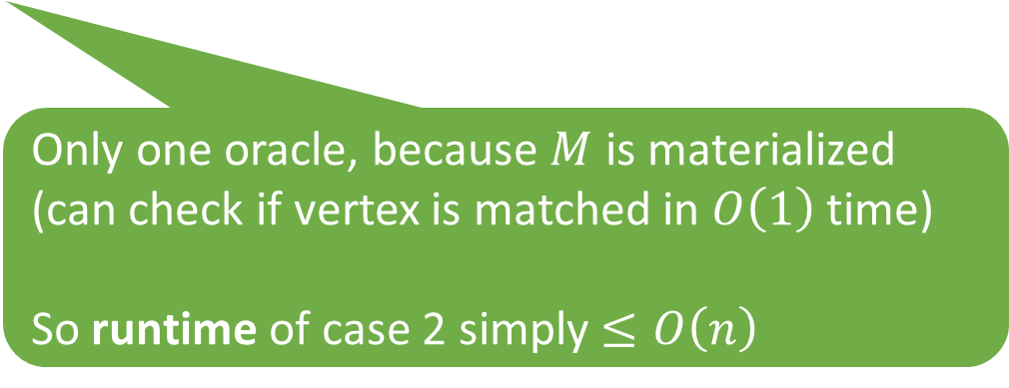
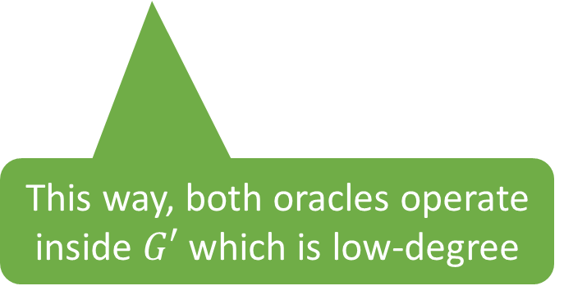

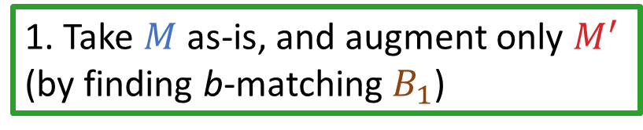
Final algorithm
$G^{′}=G[V∖V\left(M\right)]$ (has low degree $\sqrt{n}$)
Materialize a matching $M$ by subsampling.
Then $G^{′}=G\left[V∖V\left(M\right)\right]$ has deg $≤\sqrt{n}$.
Return larger of two estimates:
$$B_{2}$$
$$B_{1}$$
$$M$$
$$M′$$
1. Take $M$ as-is, and augment only $M^{′}$ (by finding b-matching $B_{1}$)
2. Augment only $M$ (by finding b-matching $B_{2}$)
This way, both oracles operate inside $G′$ which is low-degree
Only one oracle, because $M$ is materialized (can check if vertex is matched in $O\left(1\right)$ time) So runtime of case 2 simply $≤O\left(n\right)$

Slide 17
Runtime of case 1
$G^{′}=G[V∖V\left(M\right)]$ (has low degree $\sqrt{n}$)
$$B_{2}$$
$$B_{1}$$
$$M$$
$$M′$$
1. Take $M$ as-is, and augment only $M^{′}$ (by finding b-matching $B_{1}$)
This way, both oracles operate inside $G′$ which is low-degree

Slide 18
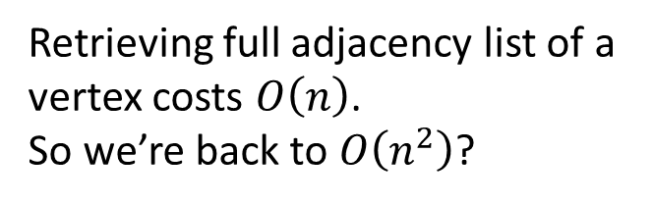
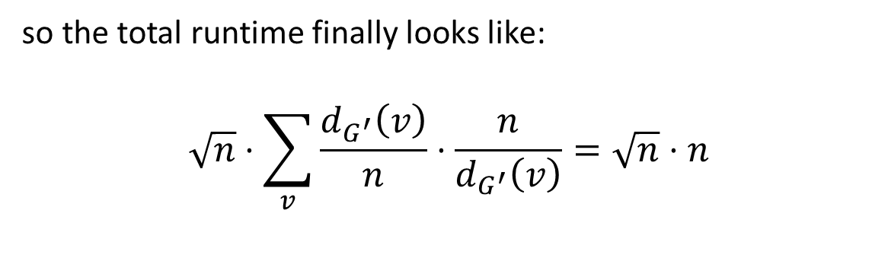

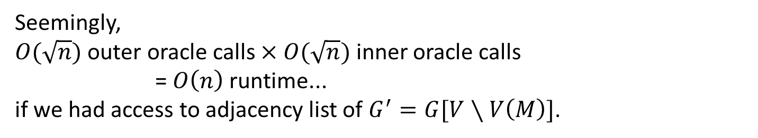




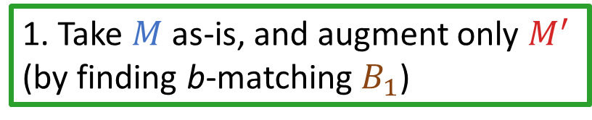

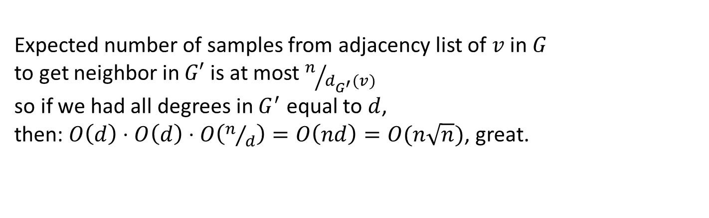
Runtime of case 1
$G^{′}=G[V∖V\left(M\right)]$ (has low degree $\sqrt{n}$)
$$B_{2}$$
$$B_{1}$$
1. Take $M$ as-is, and augment only $M^{′}$ (by finding b-matching $B_{1}$)
$$M$$
$$M′$$
Seemingly, $O(\sqrt{n})$ outer oracle calls $×$ $O(\sqrt{n})$ inner oracle calls = $O\left(n\right)$ runtime... if we had access to adjacency list of $G^{′}=G[V∖V\left(M\right)]$.
But we don’t.
Expected number of samples from adjacency list of $v$ in $G$ to get neighbor in $G′$ is at most $n/{d_{G^{′}}(v)}$ so if we had all degrees in $G^{′}$ equal to $d$, then: $O\left(d\right)⋅O\left(d\right)⋅O\left(n/d\right)=O\left(nd\right)=O(n\sqrt{n})$, great.
Retrieving full adjacency list of a vertex costs $O\left(n\right)$. So we’re back to $O\left(n^{2}\right)$?
so the total runtime finally looks like:
$$\sqrt{n}⋅\sum_{v}{\frac{d_{G^{′}}\left(v\right)}{n}⋅\frac{n}{d_{G^{′}}\left(v\right)}}=\sqrt{n}⋅n$$
Key property 2 of RGMM oracle: it visits every vertex proportionally to its degree
Key property 1 of RGMM oracle: at each step, it needs a random neighbor of some vertex
outer
inner
overhead
But what if some $d_{G^{′}}(v)$ is small?
[Mahabadi, Roghani, Vakilian, Tarnawski 25]
(Then overhead is $O\left(n\right)$, so we’re back to $O(n^{2})$?)

Slide 19
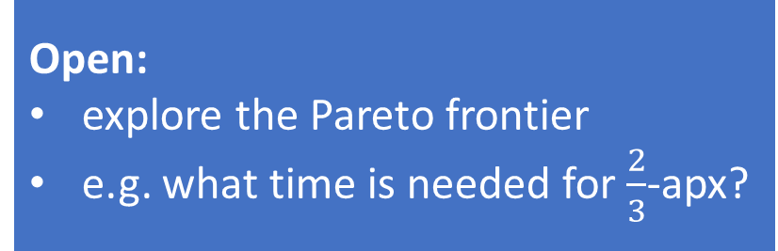
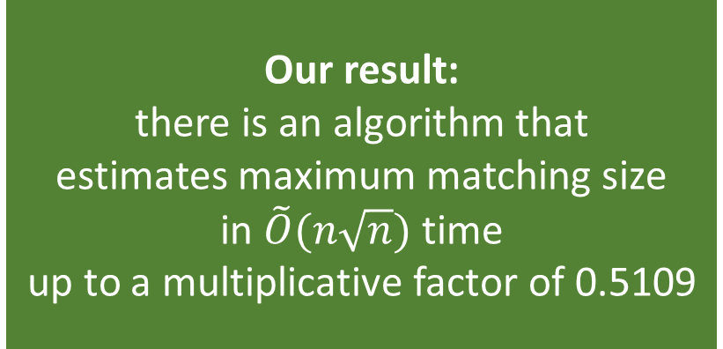

time
Our result: there is an algorithm that estimates maximum matching size in $\tilde{O}(n\sqrt{n})$ time up to a multiplicative factor of 0.5109
[BKS FOCS’23]
$$n^{2−ε^{′′}}$$
[BRR STOC 24]
$$n^{1.5}$$
[BRR FOCS 23]
$$n^{1.2}$$
[BRRS SODA 23]
[BRR STOC 23]
$$n^{1+ε^{′}}$$
[B FOCS 21]
$$n$$
[PR TCS 07]
$$\frac{1}{2}$$
$$\frac{1}{2}+ε$$
$$0.51$$
$$\frac{2}{3}$$
$$1−ε$$
apx
Open:
explore the Pareto frontier
e.g. what time is needed for $\frac{2}{3}$-apx?
good
Thank you!

Slide 20
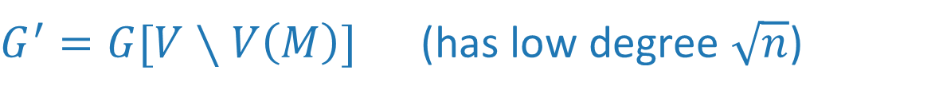

$G^{′}=G[V∖V\left(M\right)]$ (has low degree $\sqrt{n}$)
$$B_{2}$$
$$B_{1}$$
$$M$$
$$M′$$

